Slide 1
Creating Durable Documentation for Your Data Team
Kate Boettcher,
Zoe O’Reilly,
Christina Marikos

Slide 2
Introductions
KATE BOETTCHER
ZOE O’REILLY
CHRISTINA MARIKOS
One Arizona, Data Manager, she/her
Rural Arizona Action, Data Coordinator, she/her
Rural Arizona Action, Data Manager, she/her

Slide 3
OVERVIEW
00
Grounding & Purpose
03
Git integrated pipelines
Why data documentation matters & our goals for today
Using Git to create automatically versioned pipelines
01
Google workspace
Exploring what Google Workspace offers to capture organizational data
04
CLOSING
02
Github + versioned documentation
Q&A
Thank You
Understanding version control
Linking note-takers to Git
Notes:
How many of you consider yourself data people? Drop an emoji in the chat!

Slide 4
Grounding & Purpose
Notes:
Purpose: to offer three different levels for technical documentation systems within your organization
Grounding and background:
From Christina’s initial submission: Documentation strengthens collaboration, reduces ramp-up time, and ensures continuity despite turnover. With 2025 as an off-cycle year, now is the time to invest in documentation that will allow organizations to hit the ground running in 2026 with stronger infrastructure and more efficient workflows.
We are here to uplift and highlight data tools and systems that have worked for us and our teams, but we want to emphasize that the process is always ongoing and there are always new things to learn in this space. A lot of folks entering into data work experience the learning part alone. Therefore, if at any point you feel overwhelmed by the information shared today, we suggest focusing on just one process within your organization that you are hoping to change. As much as our external work is focused on changing systems, this work is the same, in changing internal processes of how we capture our own data.

Slide 5
When we talk about data documentation, we mean…
… Building sustainable practices within an organization to capture how we interact with, store, and communicate with others about organizational data

Slide 6
Why does documentation matter for our work today?
It takes time to build data documentation practices within an organization. We can use this moment before the next cycle to structure and capture our own work.
As much as our external work is focused on changing systems, this work is the same, in changing internal processes of how we capture our own data

Slide 7
HOW OFTEN DO YOU USE DATA IN YOUR ROLE?

Slide 8
Questions to ask when getting started
How are other departments documenting their work?
How are we defining key metrics? Is it different from other team members?
What metrics do funders ask for? Who on our team tracks this and how often?
What about our process can we document in order to work more sustainably?

Slide 9
Level setting within your organization
Organization data inventory
Where does our data currently live?
Who has access to our data?
Does our access to our data expire?
Cross collaboration with other staff members
What common needs exist across all staff for data documentation?
What can be managed and structured under a data team?
What needs are there for the purpose of reporting?
How often is data needed for organizational staff (field, comms, and/or development teams) ?

Slide 10
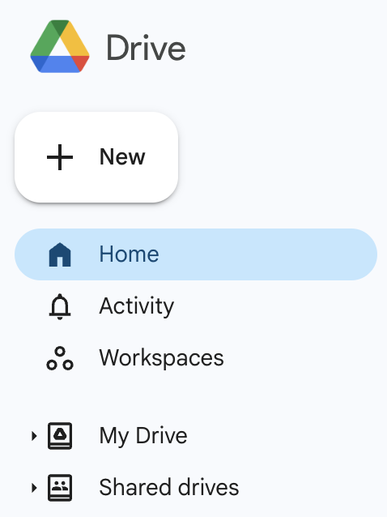
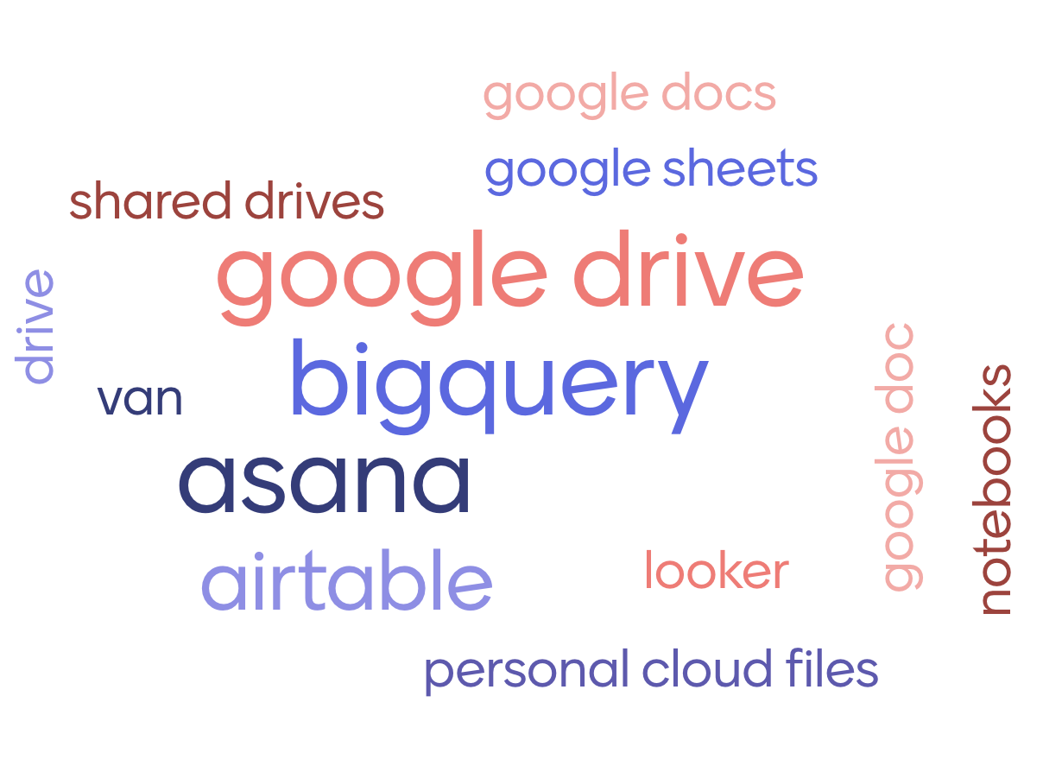

Where do we currently keep data and information?
🤔

Slide 11

Three Goals for Strong Documentation Practices
Strengthen collaboration internally and ecosystem wide
Reduce ramp-up time in on cycle years and rapid response
Ensure continuity despite turnover and get new cycle based staff up to speed fast

Slide 12
01
Level 1: Google workspace (sites, docs, drive)

Slide 13

Documentation is crucial for preserving and disseminating specialized knowledge that might otherwise be lost or siloed.
Allows us to avoid losing institutional knowledge over time.

Slide 14
Why Documentation Matters Long Term
Robust documentation is a lifesaver for any organization
Our industry is prone to cyclical turnover and the need for rapid responses
It is not just about recording what exists, but also about preserving the knowledge of the how and the why surrounding the data

Slide 15
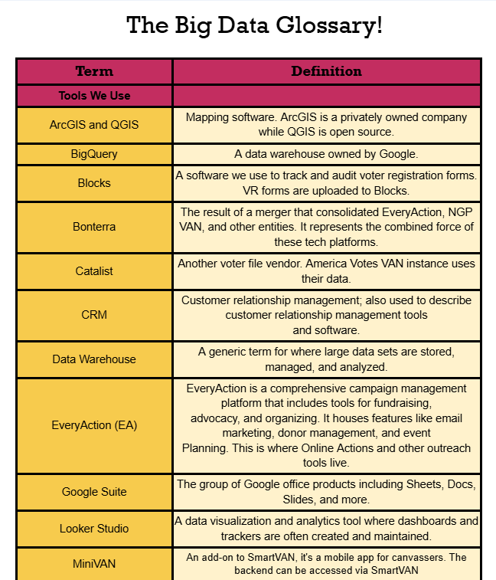
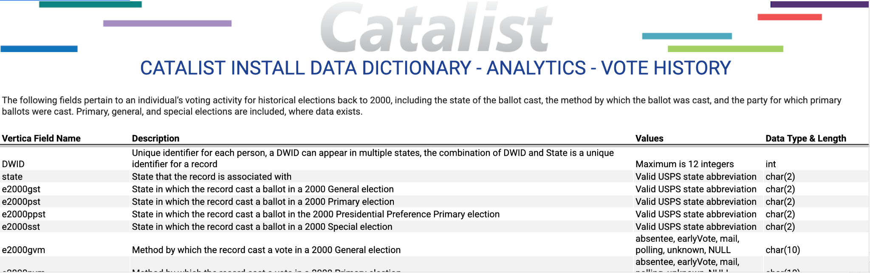
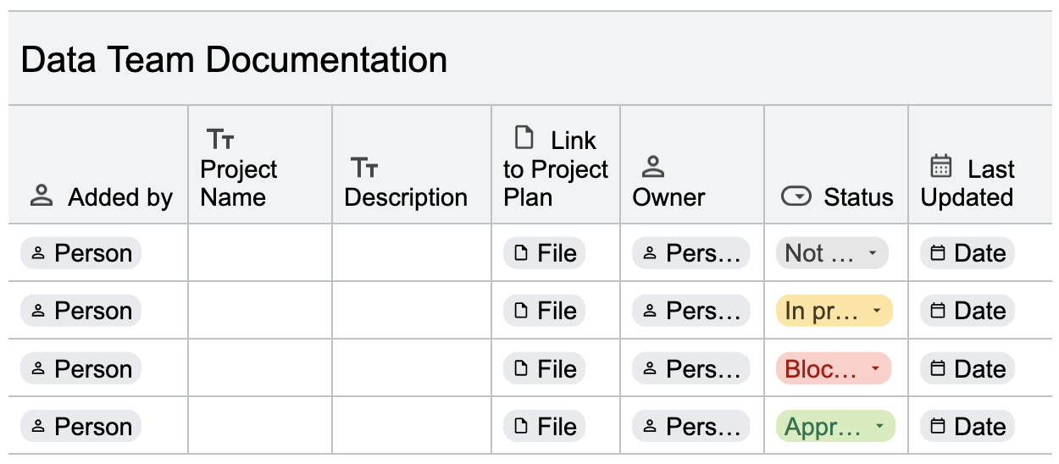
Level 1 Documentation
Data Dictionaries/Glossaries
Speak the same language
Quarterly Reporting
Maintain and expand workflows
Internal sites
Centralized organizational data

Slide 16
Documenting with Terminology Glossaries and Data Dictionaries
A data dictionary or glossary establishes certain ground rules for documentation and helps to ensure that everyone is speaking the same language.
It ensures consistency in data use across the organization and reduces ramp-up time for new staff members.
Google Workspace
Google Docs

Slide 17
Documenting with Terminology Glossaries and Data Dictionaries
The Big Data Glossary image seen here is an example of a simple, non-technical data document.
While this is a glossary and not a data dictionary, it is an example of a clean document that outlines the terminology, and the shared language, used throughout your org.
These tools are especially useful when bringing new staff up to speed.
Google Workspace
Google Docs

Slide 18
Creating Your Data Dictionary or Glossary
Four Key Points
OWNERSHIP
FORMAT
Assign ownership of the data dictionary to a specific individual or team to ensure accountability and regular updates
Create a spreadsheet or a document format that suits your organization's needs and preferences
COLLABORATE
MAINTAIN
Define and document terms and definitions. This is not just common industry terms but the shared language used to communicate data tools to non-data staff
Regularly review and update. Versioning the file lets you keep track of changes over time. The versioning is automatic if you use a web-based file system (or wiki) like Git.
Notes:
Here we have four key points to include in building a data dictionary or any robust documentation.

Slide 19
Building the Initial Document
Start with basic information about the data
Term or Field Names
Include a full “human readable” name of the element if the dataset uses codes or abbreviations
Define and describe each term/field name
Enable versioning (Christina will go further into versioning a little later on)
Google Workspace
Google Docs
Notes:
We will provide a document that includes more information and links to the resources we share in this presentation.

Slide 20
Google Workspace
Data Dictionary Example
Notes:
Previously we looked at a simple data glossary, now we are looking at a more complex table that would be used in writing queries.
This relates to a specific table that exists in our data warehouse, listing fields and values we can write queries for and join on.

Slide 21
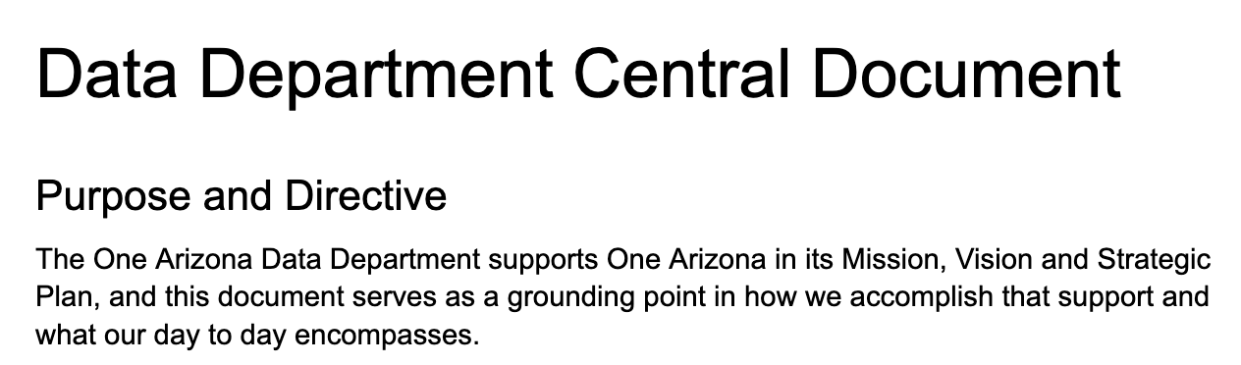
Quarterly Written Documentation
Co-creating central documentation with team to capture work that can include:
Team structure and role descriptions
Project and program descriptions
Links to key documents or spreadsheets that team uses regularly
Security norms for data access
Data partnership/contract descriptions
Aspirations for team projects
Google Workspace
Google Docs

Slide 22
Quarterly Written Documentation Process
Create a general annual timeline of your organization with your team so that you know what to expect for data deliverables
Schedule out quarterly times to meet for the purpose of collaborative documentation
Build documentation into workflow by regularly asking how information is going to be captured
Accept that the process will shift depending on your team’s needs
Google Workspace
Google Docs
🗓

Slide 23
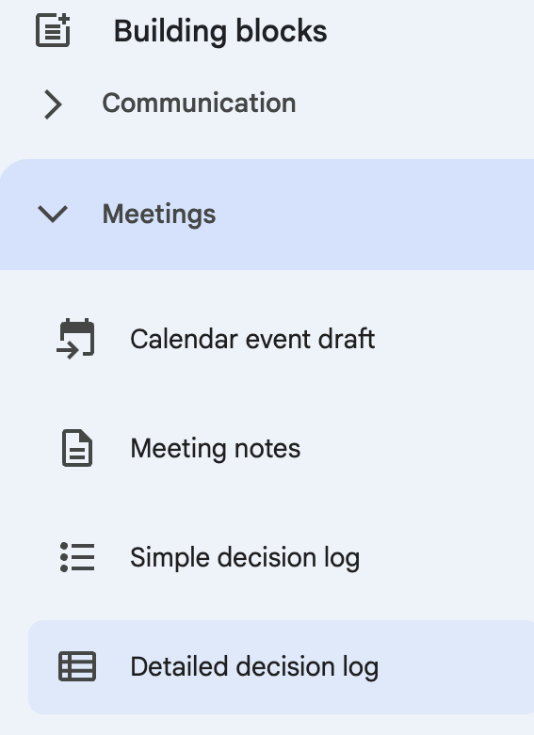
Quarterly Written Documentation -
Utilizing building blocks within Google Docs to help visualize team structure and documentation workflow
More manual to update but is an option to get started
Google Workspace
Google Docs

Slide 24
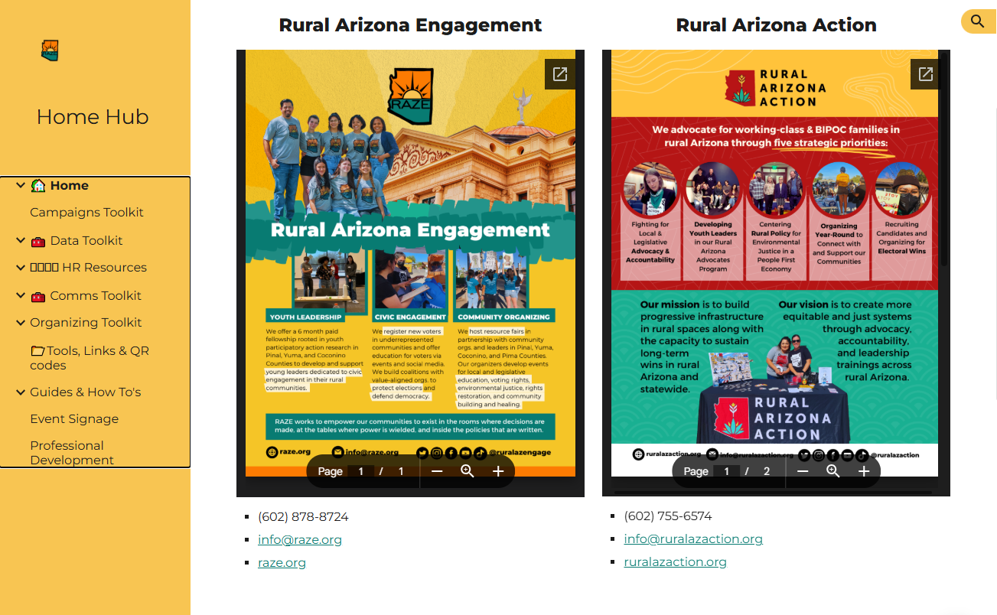
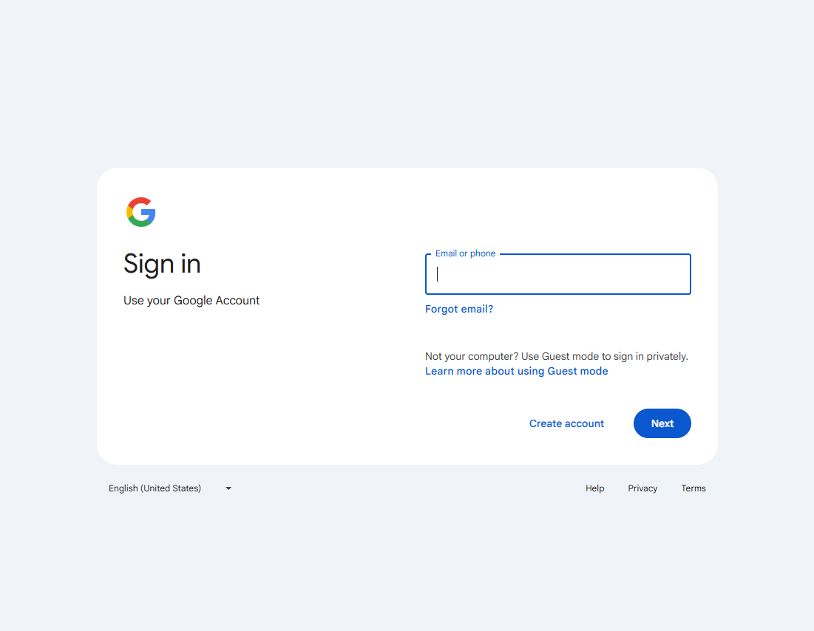
Creating Internal Websites
Our home hub is used to centralize company resources and ensure documentation, policies, templates, and communication tools are all accessible from one place.
Internal Google Sites are only accessible to users within your organization’s domain (unless you specify otherwise)
Only requires organization email address
No coding required
Google Workspace
Google Sites

Slide 25
Creating Internal Websites
Our home hub hosts resources for our separate c3 and c4 programs.
Providing commonly-used resources in this home hub empowers our program leaders to access their commonly-used tools without having to search through inboxes, drives, or request help from Data.
Google Workspace
Google Sites

Slide 26
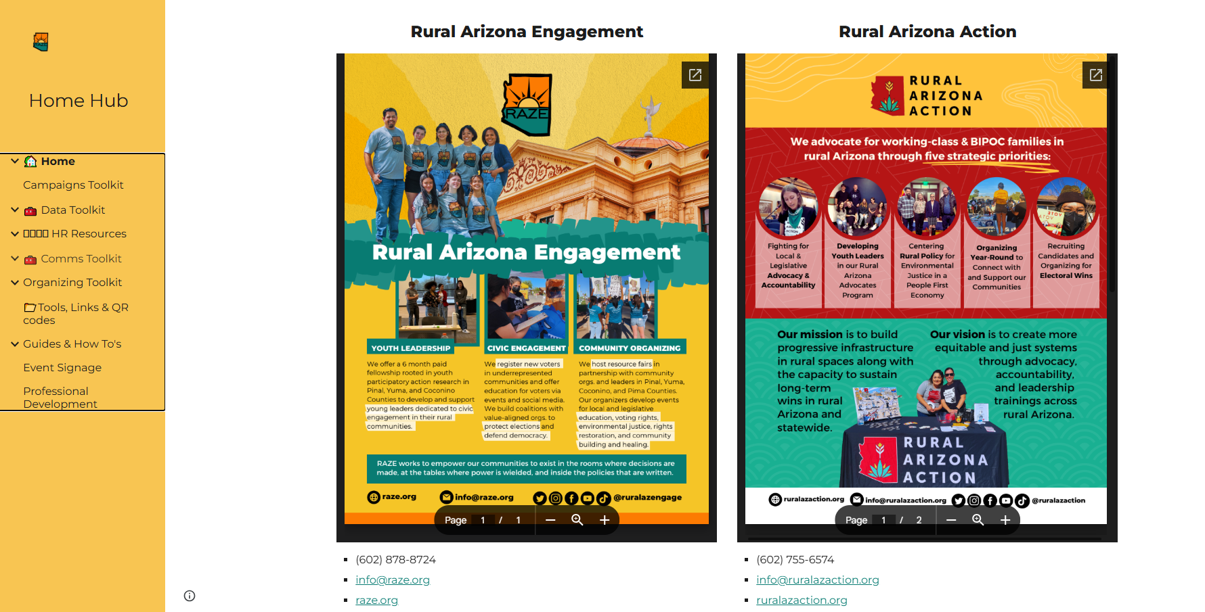
Google Workspace
Google Sites
Notes:
This site has persisted throughout multiple staffing changes and expanded alongside our programs. I’d like to note that this internal hub we are sharing now was created before either Christina or myself came on board, by Ashley Brennan now with America Votes.

Slide 27
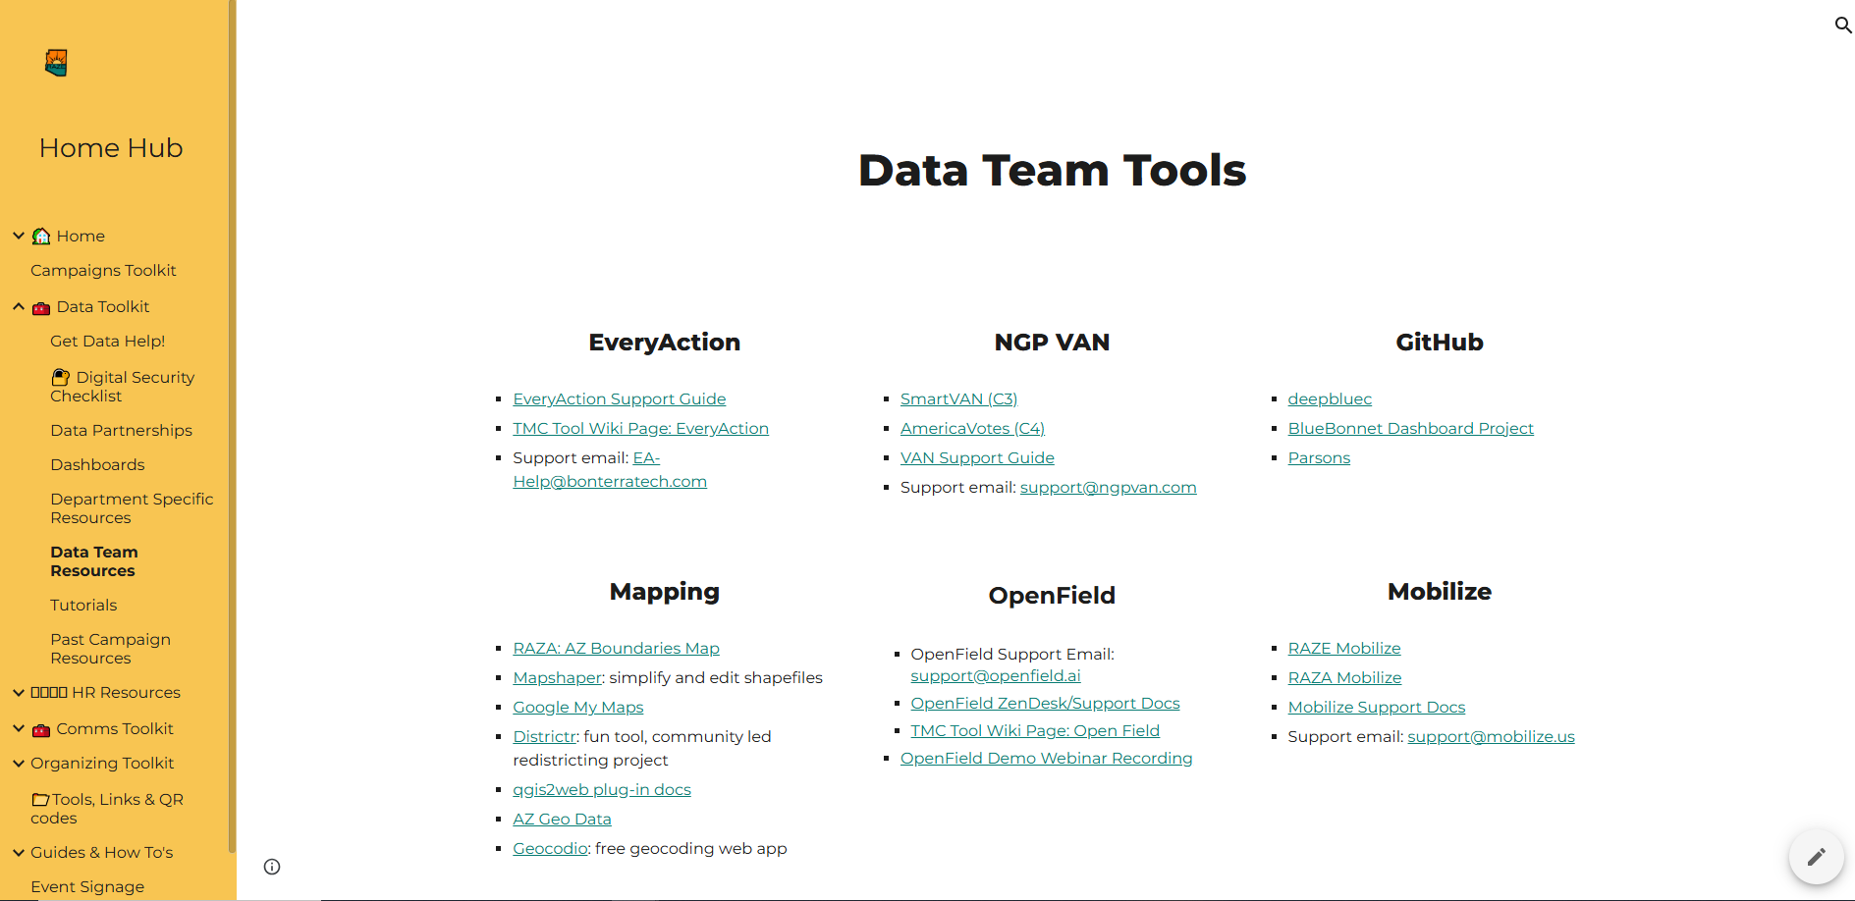
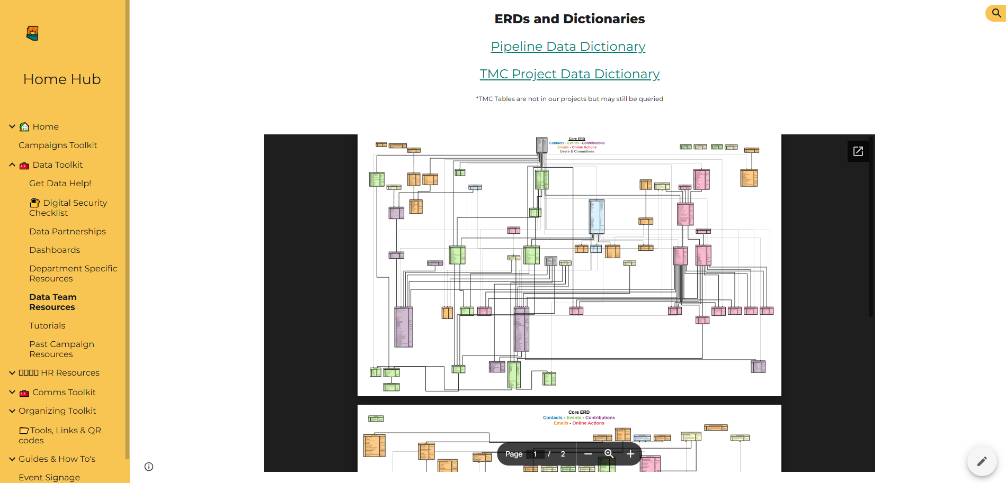
Host Internal and External Resources
Internal sites can:
Host onboarding guides, IT support schedules, tutorials, and embedded forms for support requests
Embed documents, calendars, forms, and other dynamic content from the Google ecosystem
Provide links to external resources, such as the TMC Data Dictionary
Google Workspace
Google Sites

Slide 28
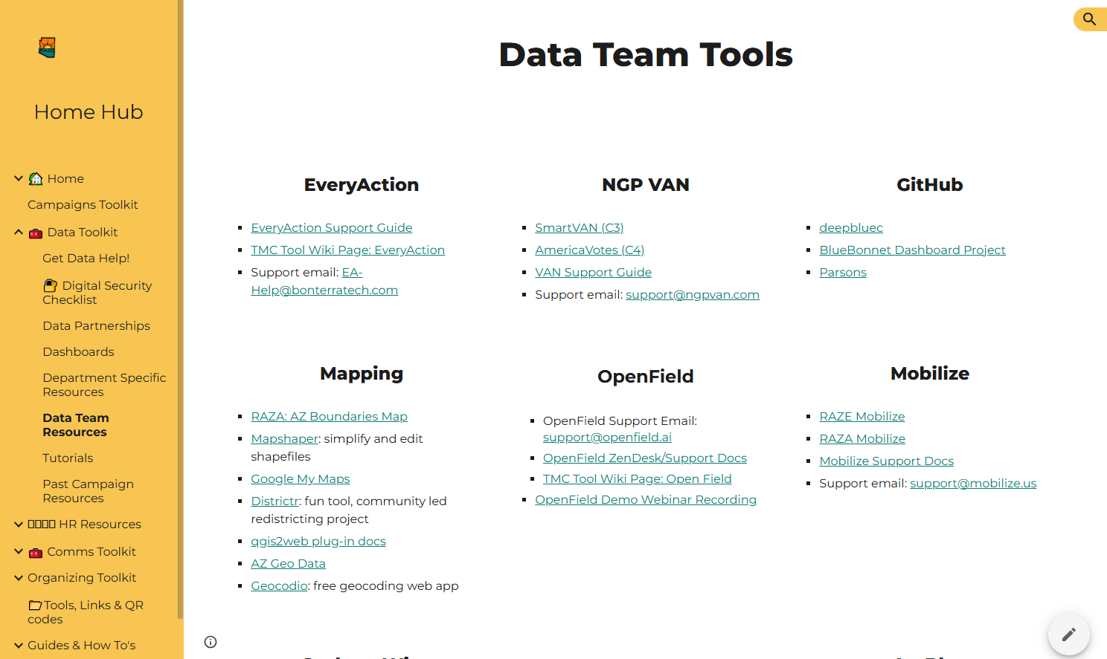
Google Workspace
Google Sites
Notes:
Internal sites can be a great space to store non-technical information and provide interfacing with non-tech staff. Supplying these resources can make our processes more transparent to non-data team members and easily findable.

Slide 29
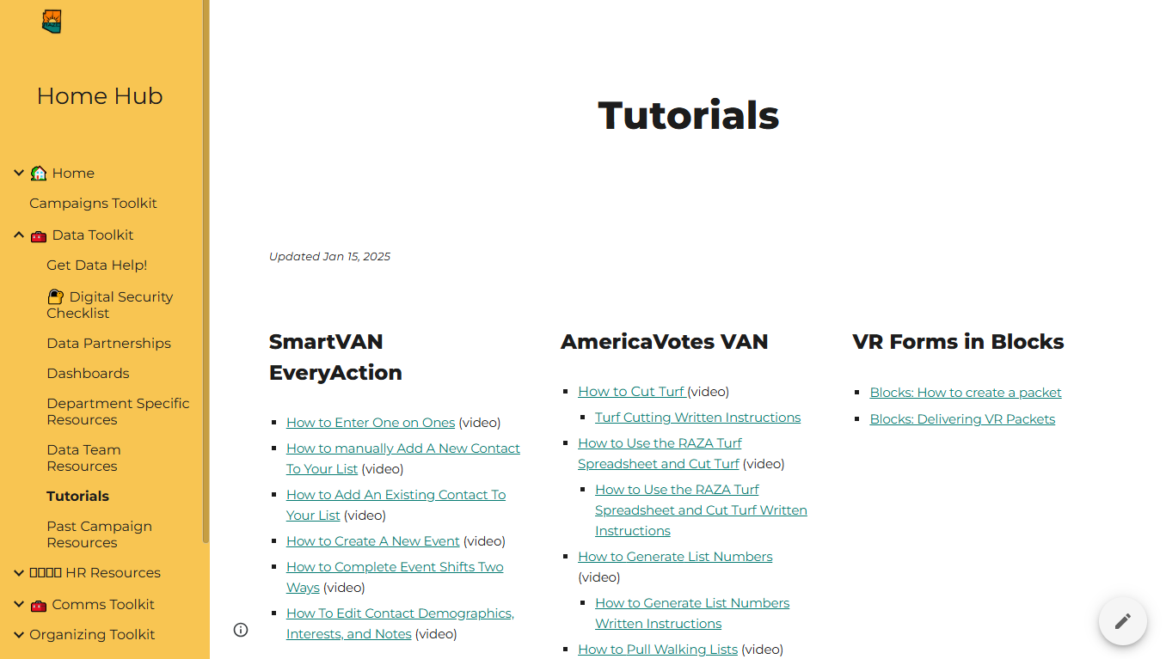
Google Workspace
Google Sites
Notes:
A handy place to host tutorials for cycle-based staff as well as day-to-day activities.

Slide 30
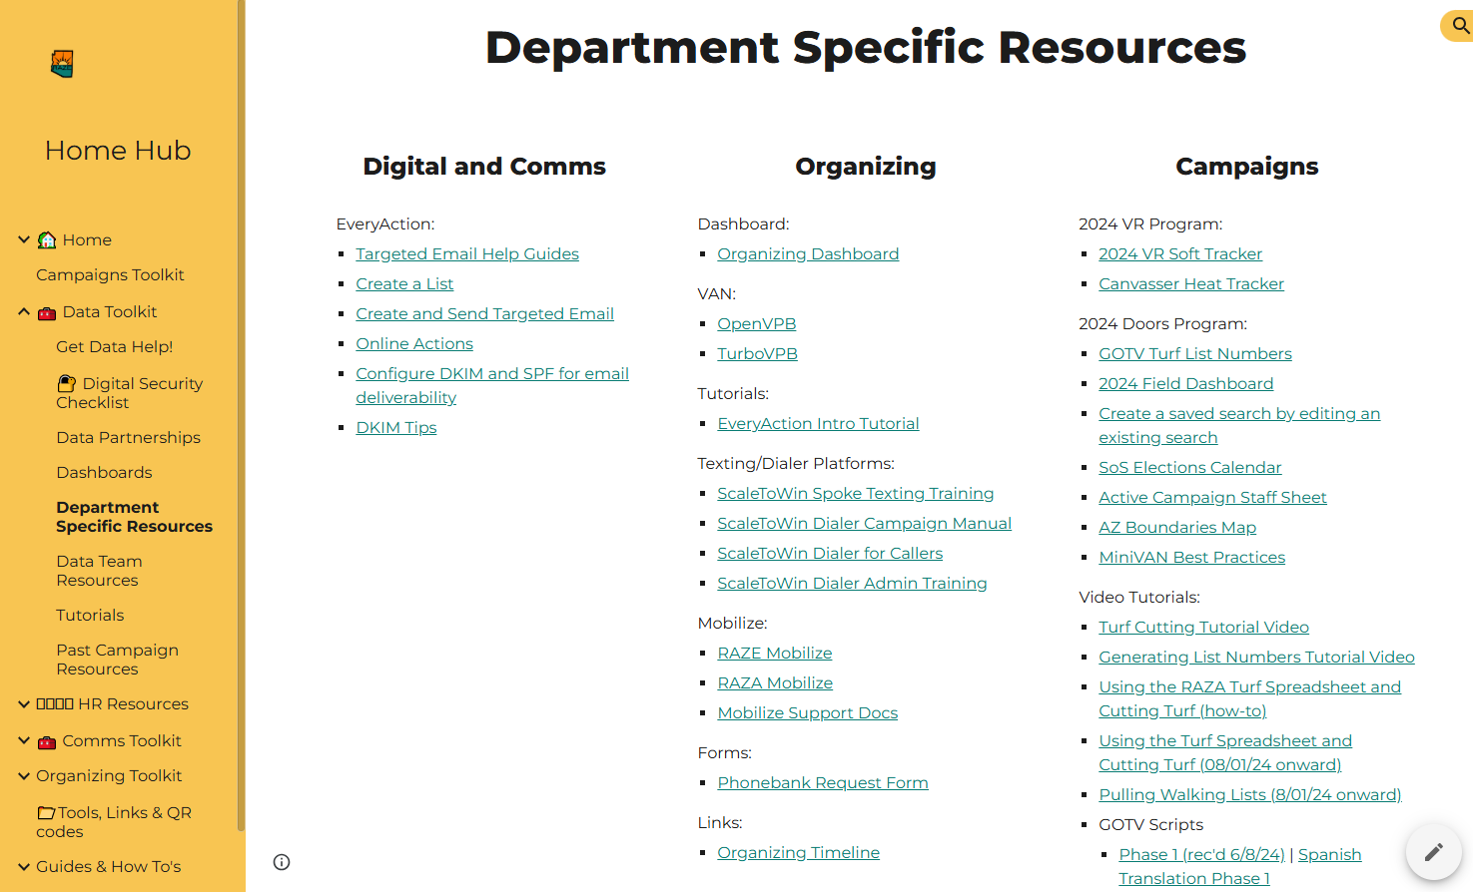
Google Workspace
Google Sites
Notes:
There is no one right way to document your processes. The first step is identifying what you already have, piece-meal and possibly outdated though it may be, try to avoid tossing everything out and starting from scratch. Chances are good there are already existing pieces and attempts at documentation that you can tie in as you build for 2025 and beyond.

Slide 31




DATA FLOW AS A PIPELINE
Example: VAN daily report uploaded manually to Google sheets daily,
which is then connected to BigQuery and visualized in Looker
Which report gets sent from VAN?
Is the data cleaned or transformed?
How are queries structured and saved?
Who needs access to underlying data to keep the dashboard alive?
Notes:
This is a simplified illustration of a data pipeline where we see each set point of transfer (we are using the G suite for this). However, none of these set points are automatically preserved and each of them can easily break down without documentation. Can you tell me a simple pipeline at your org that is not automated or well documented? Do you delete columns before manually uploading to van? What queries are you writing and what are their dependencies? What issues in the preceding steps could cause a failure in the final Looker dashboard? Christina will dig a bit deeper on these pipelines later on.

Slide 32
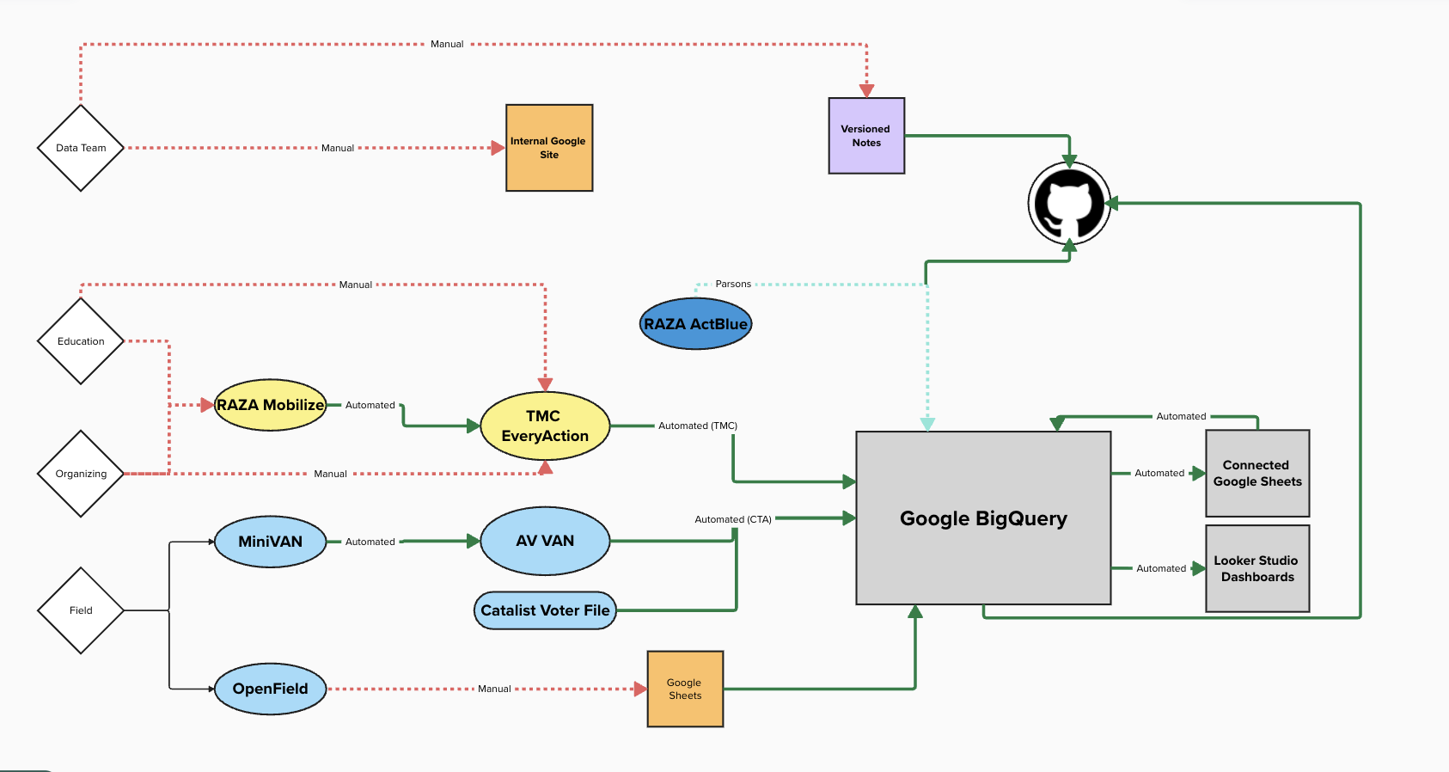
Visual pipelines and dictionaries
Visual representations can be a great tool for illustrating processes and flows. This is helpful not just for your data team documentation, but to share with non-technical stakeholders.
Laying out workflows visually can help identify where pieces are missing or need more documentation, as well as provide a birds-eye view of the entire process.
Google Workspace
Google Docs
Notes:
These kinds of visuals are helpful for providing context that can reduce ramp-up time for new data people, as well as ensure structural continuity.

Slide 33

Pipeline diagram for a specific tool (slide 30)
Program specific data diagram
Bird’s eye view whole org data flow diagram
Frequently used queries + datasets diagrammed
Funding deliverable metrics diagrams (next)
Tools and contracts diagram
Mural/Diagramming
mural.co is a free collaborative visualization tool that we use, it’s not the only option for this sort of work. There are lots of visualization tools that can be used.
Here are some examples of how we use visual diagrams:
Notes:
Can draw pipeline in Mural and elaborate on specific pieces

Slide 34
When to draw a picture, and how to pick the right fidelity
Consider your audience and your purpose
Communicate technical insights or needs to non-technical staff
How data moves from the work on the ground to the impact that your org can report
What tools/contracts you need and how they fit into your work
What needs to be reported in which systems for a funder to get the deliverables needed
Create a broad view of how data flows and whether it’s automated or manual
Audit your manual data flows in the process of improving automation
Understand which partners create which automated syncs for you
Understand when something breaks where to root for the underlying issue
How you built a data pipeline
Document frequently used workflows for new or cycle based data staff onboarding
Frequently used queries and datasets
Reporting pipelines for a program or project
Notes:
Visuals can facilitate our collaboration and communications so, when does it make sense to use visual aids?

Slide 35
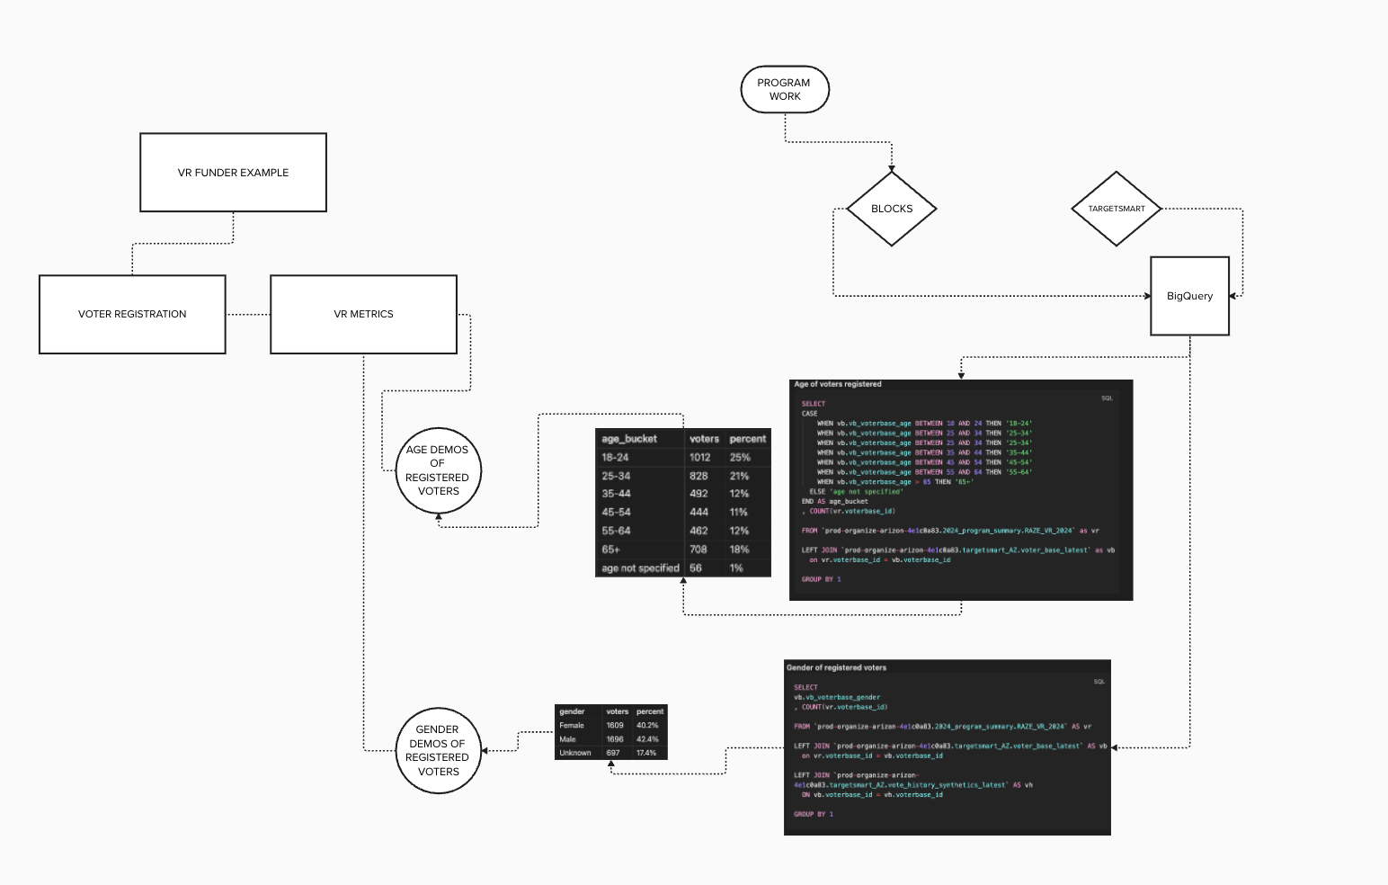
FUNDER DELIVERABLE METRIC DIAGRAM
Notes:
In this example, because we’ve included code blocks the audience is technical staff (anyone who might be pulling the report in the future), the purpose is to reproduce funder deliverable metrics in the same manner year to year.

Slide 36
LET’S REVISIT THE POWER OF VISUALS
Notes:
This diagram shows the connections and flow of information between several departments. This has helped identify where weak spots are - for instance, if someone attended an Education event but was not manually entered into EveryAction, they won’t appear in the final dashboard. Or when we had an issue receiving the catalist voter file, it impacted our ability to create the queries used to keep the Looker dashboard updated.
For instance, this diagram can be used to illustrate "In order to get you X as a deliverable, These steps need to happen."

Slide 37
QUESTIONS BEFORE WE MOVE ON?
Notes:
What sort of process could your organization illustrate with this kind of process?

Slide 38
02
Level 2: Github + versioned documentation
Notes:
Quick pause to make a github account + install github desktop

Slide 39
Google Docs are great for real-time collaboration
But can be hard to search, hard to structure, and easy to forget
Versioned note systems add structure, hierarchy, and long-term clarity to your internal knowledge
Why Move Beyond Google Docs?
When Google Docs Fall Short
Notes become scattered across folders or people’s Drives
They lack a clear version history
Docs go stale, get duplicated, or lose context
You have to manually remind others where things are
What Versioned Notes Add
Use folders, tags, backlinks, and consistent formatting
See how documentation evolved, not just what it says now
Build a shared system, not just a pile of documents
Better support for technical documentation and code snippets
It’s Not Either Or!
Different Platforms for Different Functions
Google docs are better at real-time collaboration
Versioned notes are best for durable docs meant to outlast one project, person, or cycle
Git synced notes create a durable backbone for technical docs, while Google cloud allows day to day flexible workflows
BEYOND GOOGLE DOCS - VERSIONED NOTES THAT GROW WITH YOU
Structured Note-Taking for Documentation You’ll Actually Reuse

Slide 40
WHY VERSION CONTROL?
The Foundation for Reproducible, Collaborative, and Sustainable Data Work
REPRODUCIBILITY
COLLABORATION
Track what changed, when, by whom, and why—and roll back to earlier versions when needed. This makes it easy to recreate past results, debug issues, rebuild reports, or reference the exact queries used in prior campaigns.
Multiple people can work on the same files without conflicts. Git workflows like branching and merging let teams test edits safely, review each other’s work, and integrate changes intentionally.
CONTINUITY
ACCOUNTABILITY
Turnover or role changes won’t derail your systems. Version history shows how documentation and code evolved, making it easier for new staff to step in and pick up where others left off.
Every change is logged with a name, time, and reason. This built-in audit trail promotes transparency and helps teams uphold shared standards for data and documentation.

Slide 41

SLIGHTLY MORE COMPLEX, BUT WORTH IT
Versioned notes have a learning curve, but they offer greater durability and structure, especially for teams that need to revisit complex data processes cycle to cycle
Versioned notes aren’t a replacement for Google or cloud based tools, but rather a complement to create durable documentation over a number of cycles…

Slide 42

In The Weeds: What is Git?
(It’s Related to GitHub, but Different)
Git is a tool that tracks changes to any file type over time
It runs locally and records what changed, when, and by whom
GitHub is the platform where you can save, review, and collaborate on that work through a user-friendly interface
Together, they allow teams to manage documentation, code, and data workflows with transparency and structure
Let’s build a conceptual basis of what Git does to re-enforce the concepts we’ll cover in the next section

Slide 43
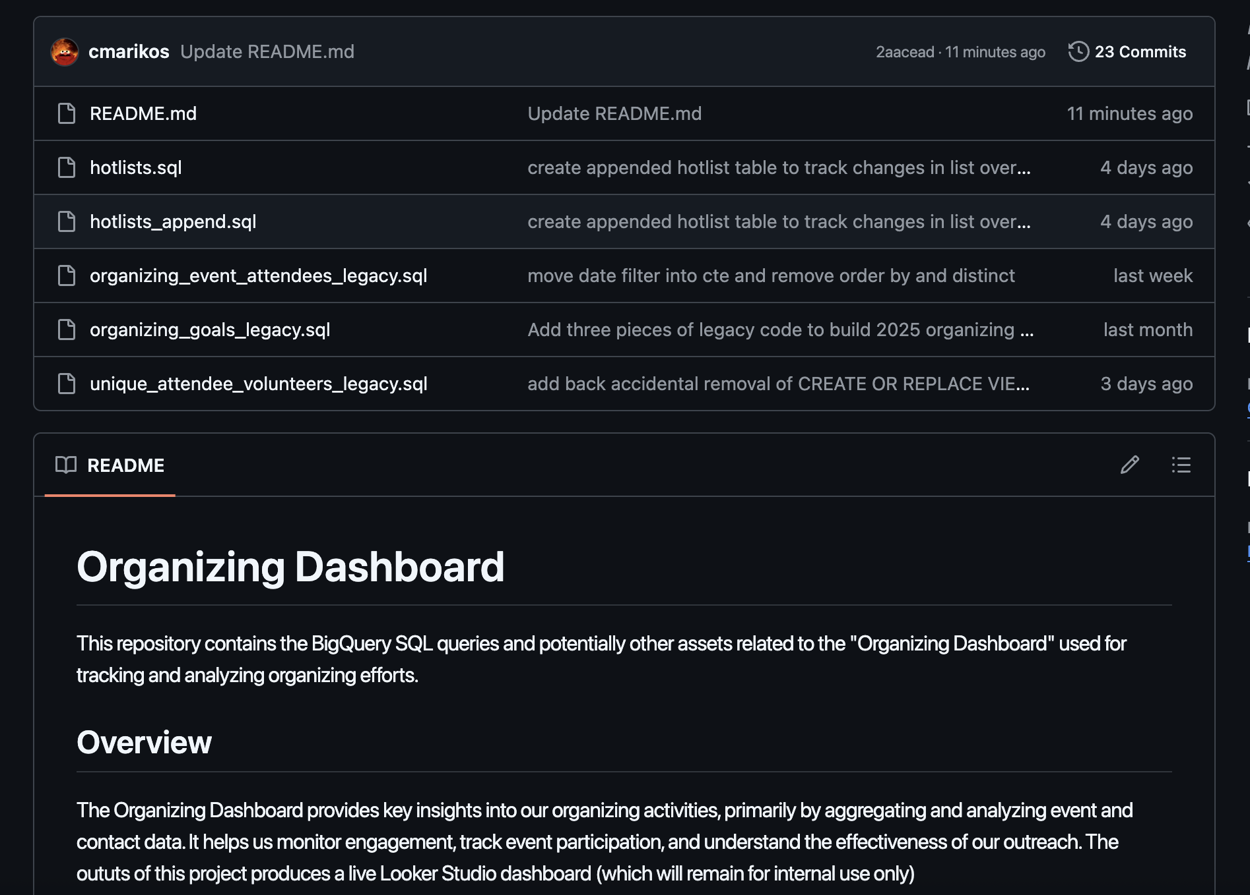
What is GitHub (and Why Use It for Documentation)?
GitHub in Plain Terms
Like Google Drive, but built for version control
Stores files in the cloud with a full edit history
Your whole team can compare versions, roll back changes, and track who did what
This is more often applied to versioned code than to just notes

Slide 44
GitHub terms to understand (glossary linked in the resources!)
Repo | To store notes, code, SQL, docs, etc., with history
Clone | First time you bring a repo from GitHub to your laptop
Fork | Your own copy of someone else’s repo on GitHub
Remote | A link to a repo so you can sync between GitHub and your laptop
Branch | A separate line of work to write without touching main
Main | The primary branch everyone shares
Commit | A snapshot of changes with a brief explanation
Push | Send your local commits to GitHub
Pull | Bring commits from GitHub to your laptop and merge
Fetch | Check for remote changes without merging
Merge | Combine changes from one branch into another

Slide 45
How to use versioned notes
Code snippets
Data dictionaries
Guiding docs for a specific technical workflow that needs to be repeated
Context and process for specific projects

Slide 46







A (NON-EXHAUSTIVE) LIST OF NOTES OPTIONS THAT CAN BE VERSIONED
Obsidian
Logseq
Trilium
Joplin
VS Code + Dendron
Highly customizable
User friendly UI
Lots of plugins
Free to use
Local first storage combined with disc encryption offers a secure baseline
Manual Git sync
Great as a shared wiki tool
Strong folder structure
Notes structured as outlines
Time-stamped journal feature creates a visual log of project progress
Outline format might not fit every team’s needs
Free + open source
Local storage with self host option
Built in Git sync
Cool tree structure
Good built-in formatting for code snippets
Multilingual UI options
Internal versioning as well as manual Git sync options
Free + open source
Local storage with self hosting option
Multilingual UI
Very customizable
User friendly UI
Limited real-time collaboration
Search and navigation isn’t the best
Free local storage, paid cloud subscription optional
End to end encryption of cloud, local storage
Third party Git sync
Higher technical barrier to entry - requires familiarity with VS code
Beautiful hierarchy structured note-taking
UI not as friendly as other options
Free + open source
Local file storage in development friendly UI
Native Git sync in VS code

Slide 47
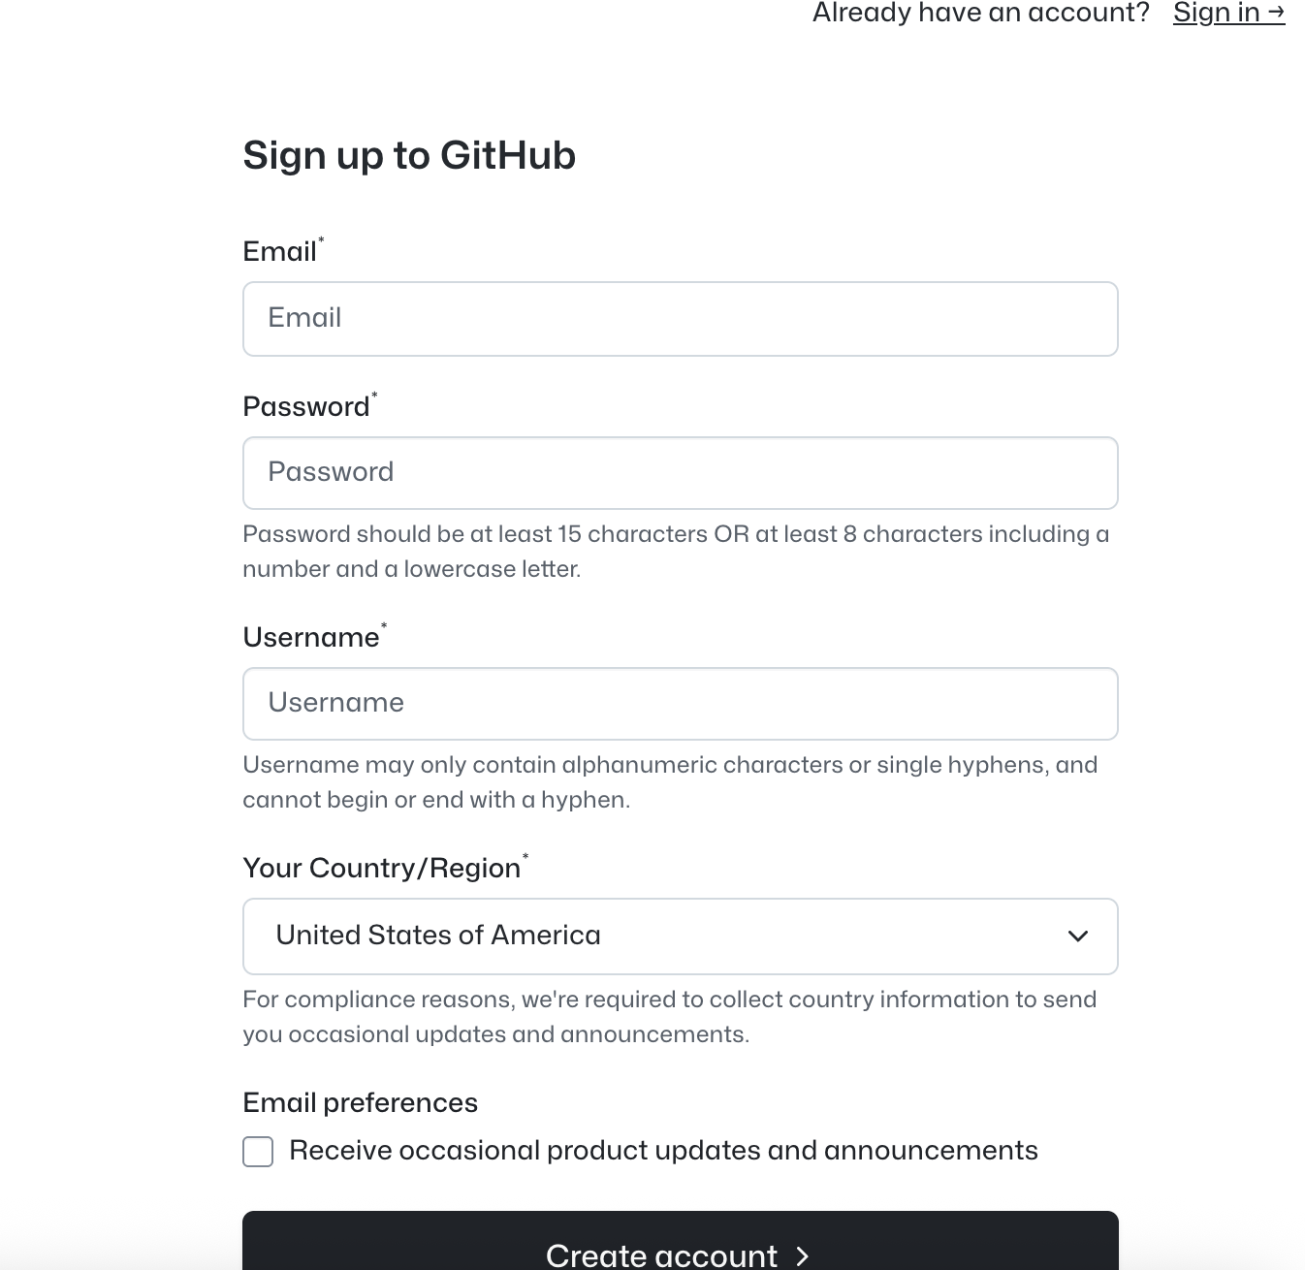
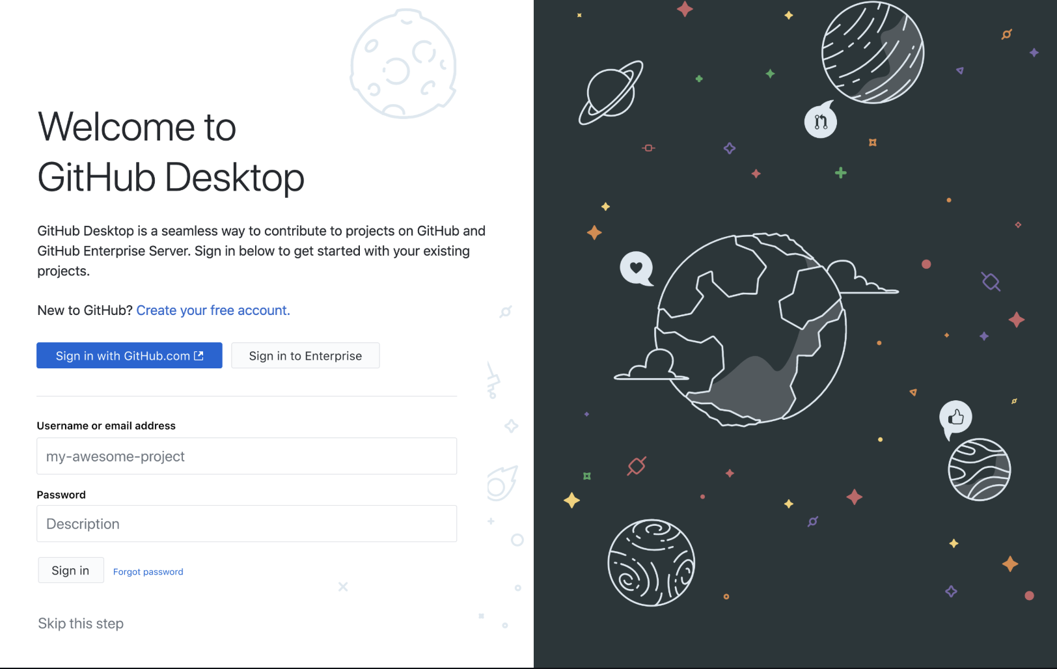
Create a GitHub
Install GitHub Desktop
Step 1
Step 2
Open GitHub Desktop and sign-in - this links your GitHub desktop account to your GitHub account
Get started on GitHub
Get set up and ready to version your notes + code using GitHub Desktop

Slide 48
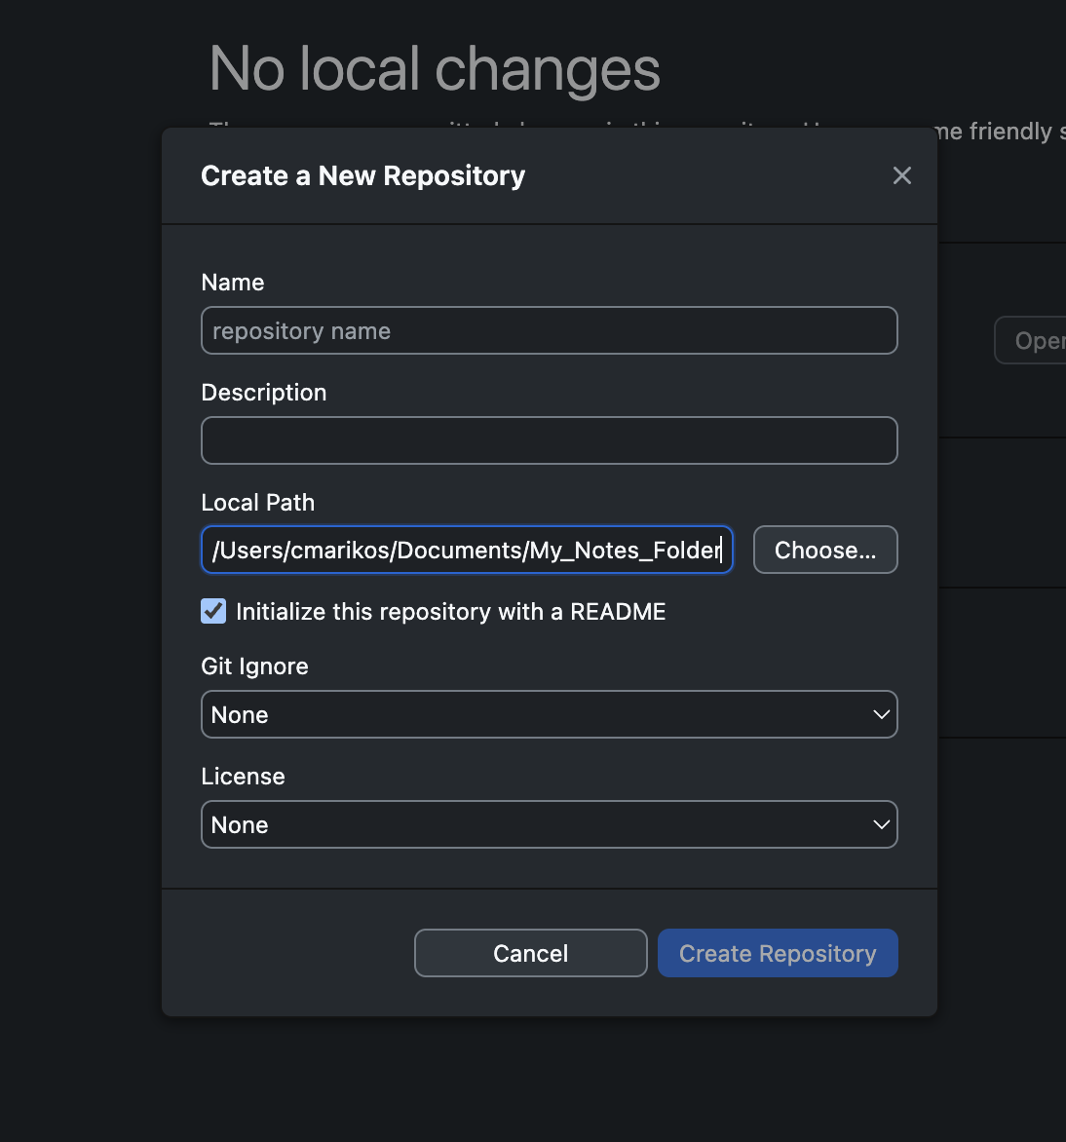
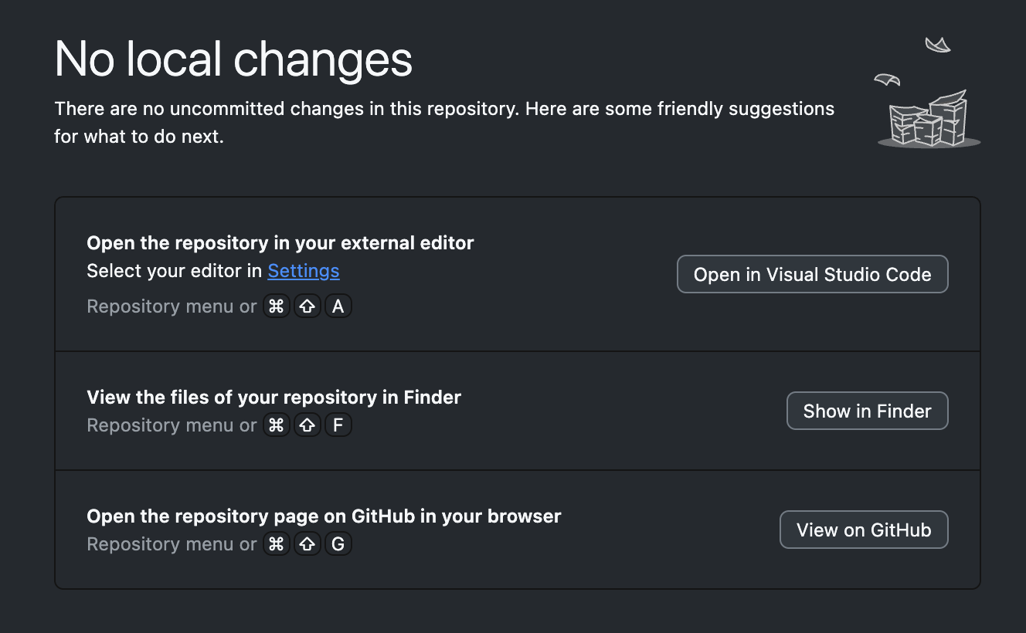
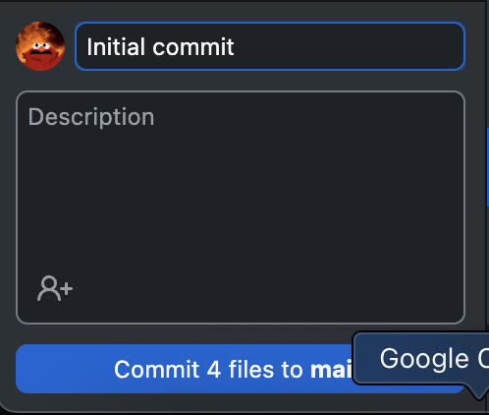
Create a new Repository and give it a name
Align the local path with the folder where your note taker stores your notes
Step 3
Step 4
Click show in finder to confirm that your path is correct
In the bottom right corner commit your files to main
Sync your note taker with Git (Obsidian example)
Get set up and ready to version your notes + code using GitHub Desktop

Slide 49
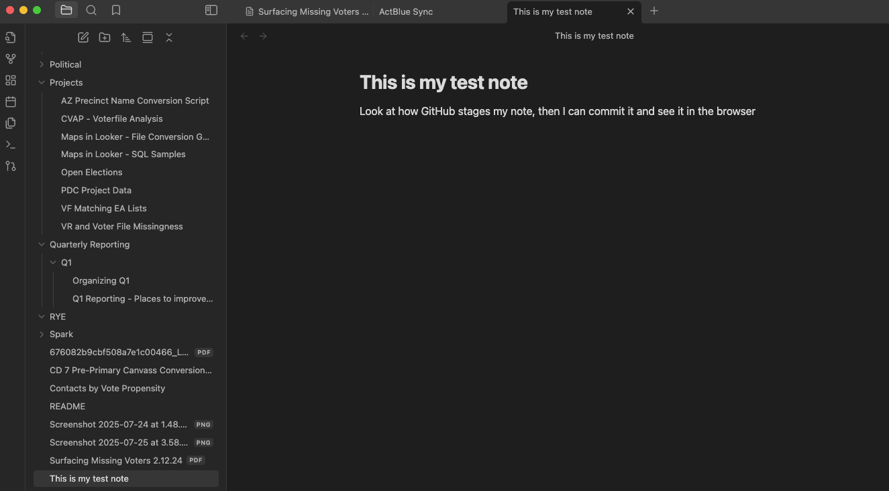
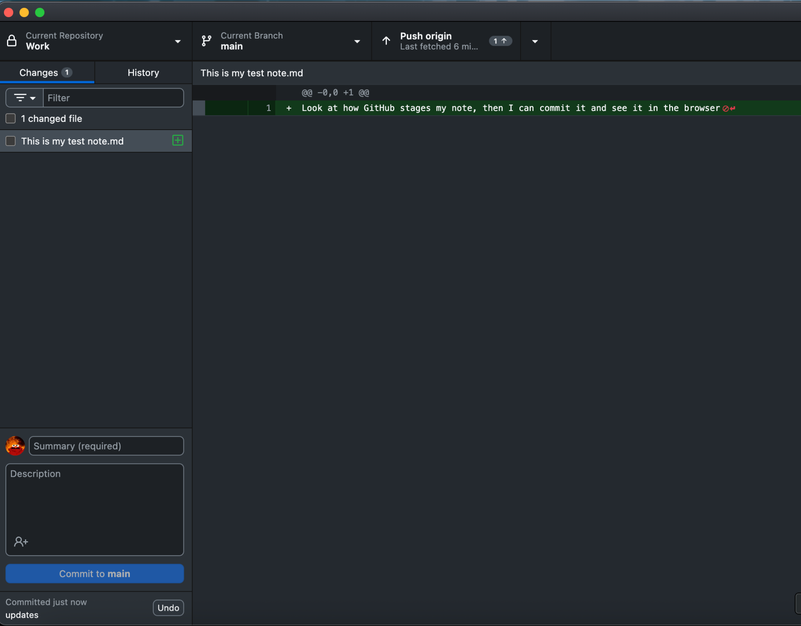
Write a new note in Obsidian
Hop over to GitHub Desktop and see how your note looks staged
Add a comment and commit it!
Step 5
Sync your note taker with Git (Obsidian example)
Get set up and ready to version your notes + code using GitHub Desktop

Slide 50
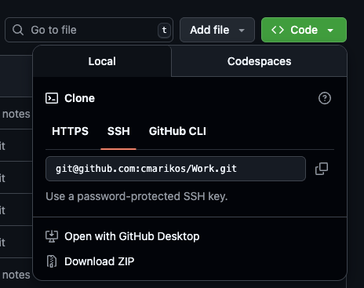
Why is this useful for notes?
You and your collaborators can:
Recreate your notes on any computer you use
Collaborate with teammates on central source of truth
See who contributed what, when
Roll back to previous versions

Slide 51
QUESTIONS BEFORE WE MOVE ON?

Slide 52
03
Level 3: Git integrated development environments + pipelines

Slide 53

A TALE OF TWO PIPELINES
We can build documentation into any data workflow if we intentionally see every piece of our work as a pipeline
The point isn’t which tool you use—it’s treating the workflow like a real pipeline: write it down, version it, test it, and make sure someone can pick it up tomorrow.

Slide 54
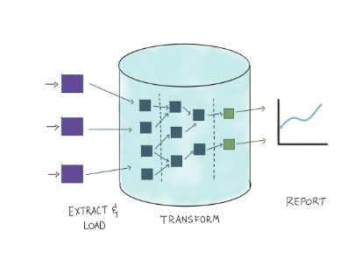
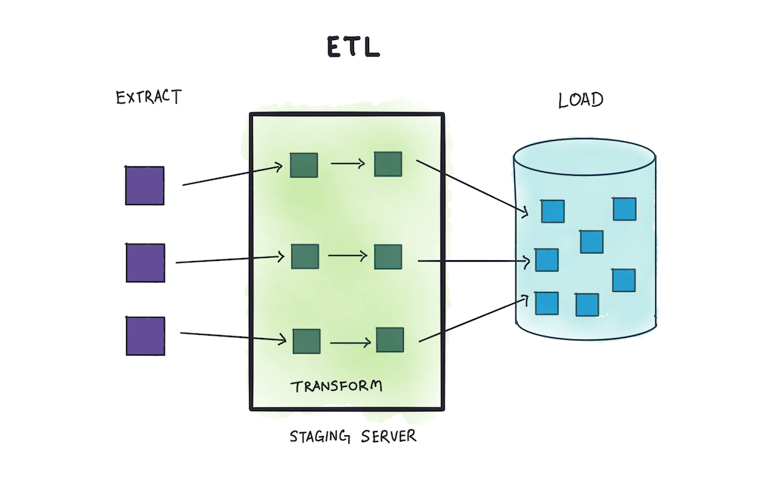
ELT: How to pipeline the “wrong” way that works
holitistics.io

Slide 55
ELT: How to pipeline the “wrong” way that works
There are four or five orgs in AZ that use a data warehouse like BigQuery at all
Those of us in this boat have a partner like CTA or TMC worry about the E&L steps, while the T (transformation) is what we do
There is no budget or intent to hire data engineers at orgs like this most times
ELT’s pitfall is that documentation and versioning are not built into the process, but rather have to be cultivated intentionally
holitistics.io

Slide 56
THE ELT PIPELINE
Let’s adjust the pipeline from earlier
VAN data gets into BigQuery, org has little control of what data comes or how it’s transformed
In BigQuery VAN data gets queried alongside other datasets like voter files that were delivered similarly
Final views are delivered to Looker to make reporting dashboards

Slide 57
The BigQuery Git Connector
BigQuery has a new-ish tool in your documentation arsenal that is important to talk about
There is some amount of set up required, but once you have it set-up it can be a really seamless way to automatically version and document your BigQuery SQL queries and python scripts
A new addition to the GCP arsenal and a relatively low friction addition to your existing pipelines

Slide 58
BUILD IN DOCUMENTATION
Every workflow is a pipeline. The tools change, but the requirement to document does not!
BigQuery Git Connector
Create a README
This is new-ish! Connect your BigQuery to GitHub
This can be a simple, human readable document in your Git repository outlining each step in your process and outlining what someone would need to recreate your work on their computer
Use Versioned Notes
Google Docs/Google Sites
You can use your notebooks to document your process alongside your technical workflows. It seamlessly incorporates code snippets and allows you to deepen notes and context around them.
If you are using Google Docs and Google Sites as a part of your documentation, this would be a good place to cross link and explain repos for active projects

Slide 59
THE ELT PIPELINE
Let’s adjust the pipeline from earlier
Data delivered from VAN can be deciphered with pipeline dictionaries (linked on Google site)
Queries can be connected to Git through BQ Repositories
A human readable readme is created to add context

Slide 60
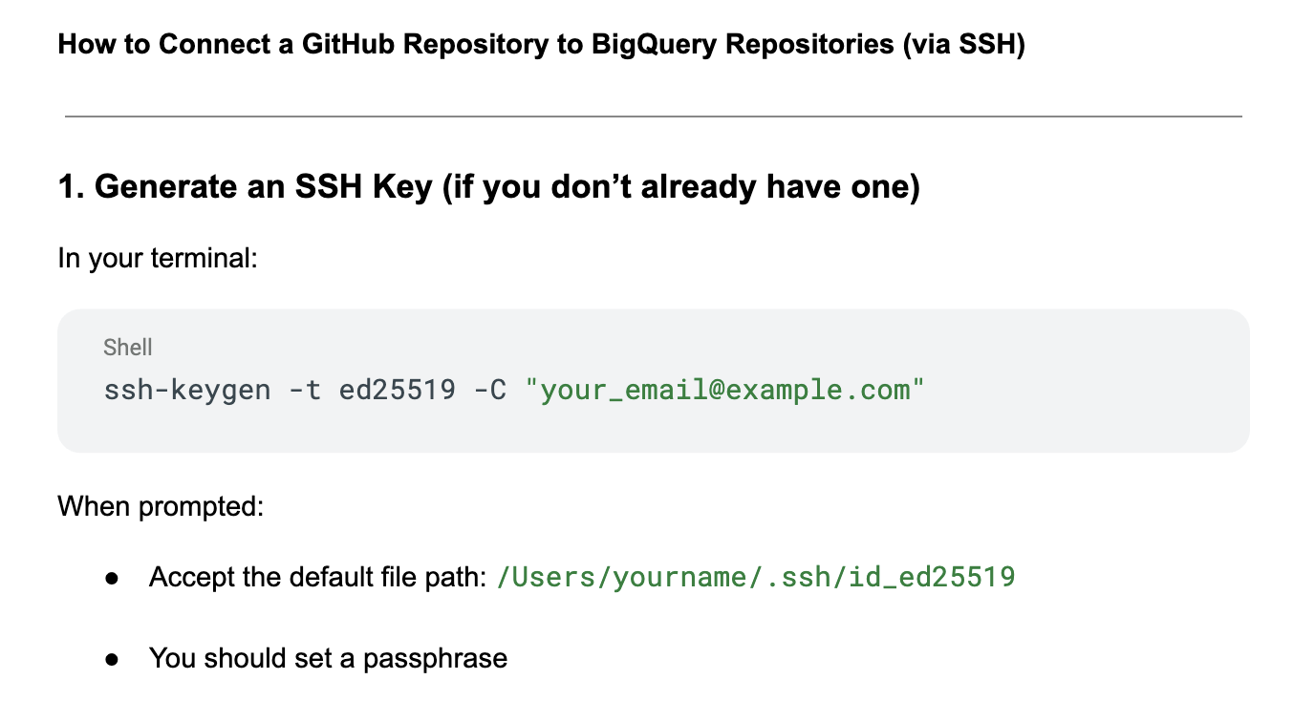
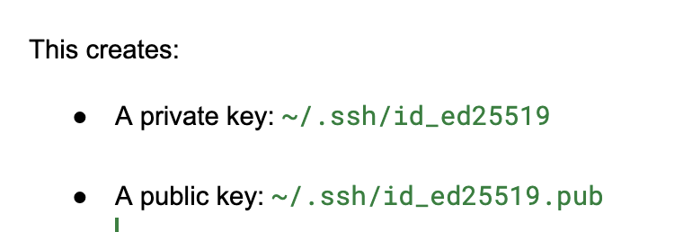
Connecting GitHub to BigQuery Repos
Save your SSH public and the passphrase for your private key in an encrypted note in your password manager for easy access - you’ll need your public key every time you configure a new repo with Git

Slide 61
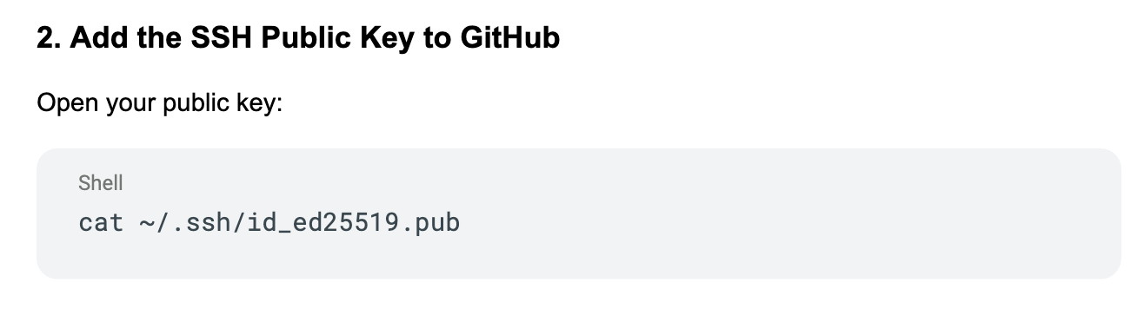
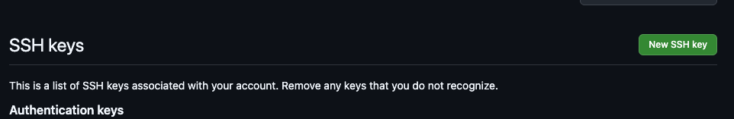
Connecting GitHub to BigQuery Repos

Slide 62
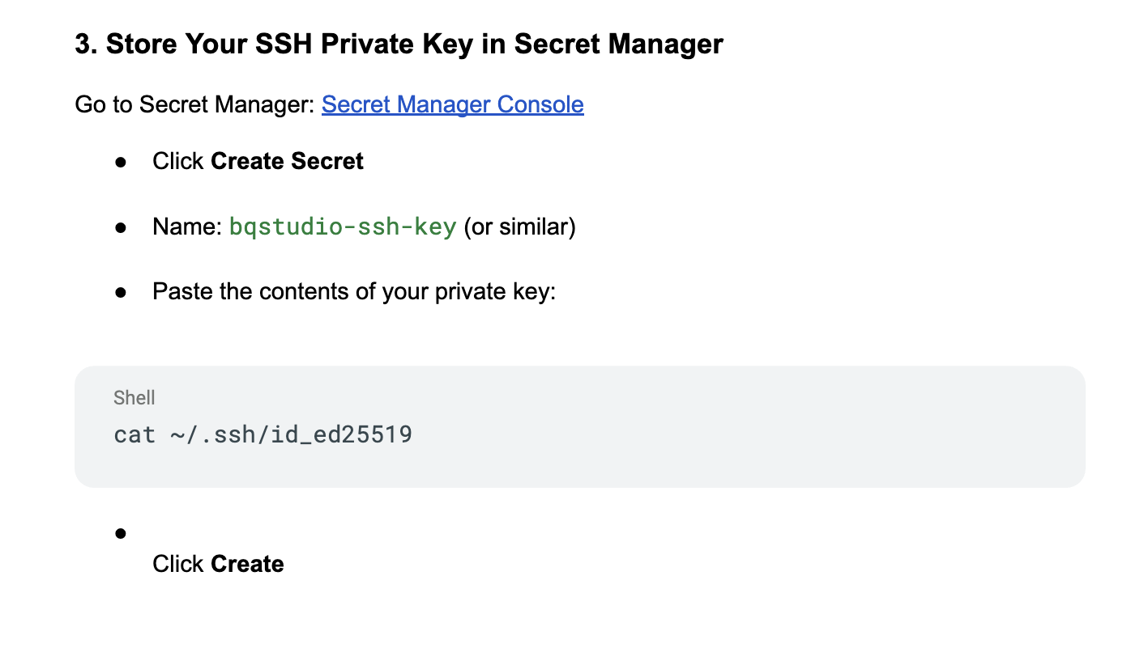
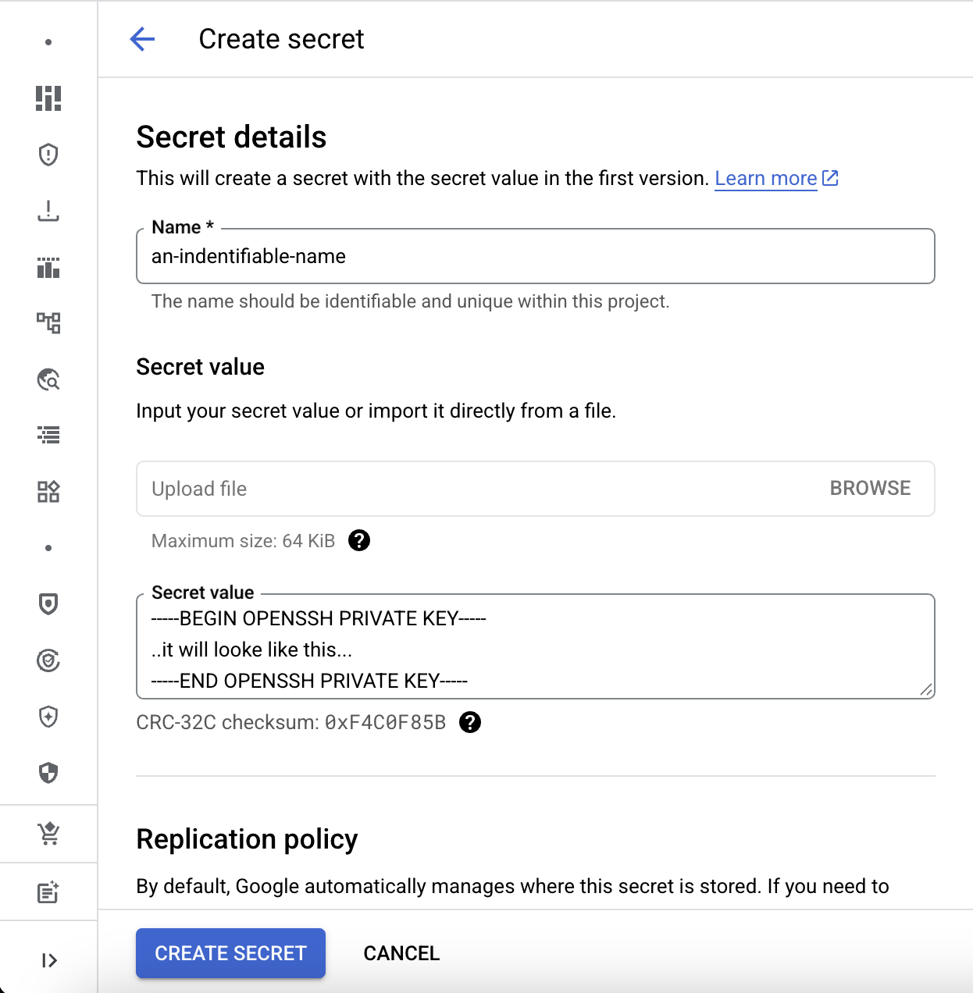
Connecting GitHub to BigQuery Repos

Slide 63
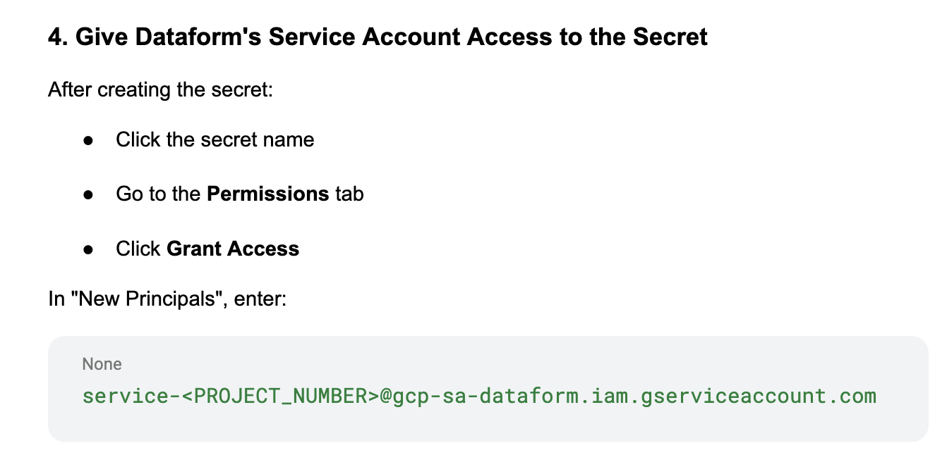
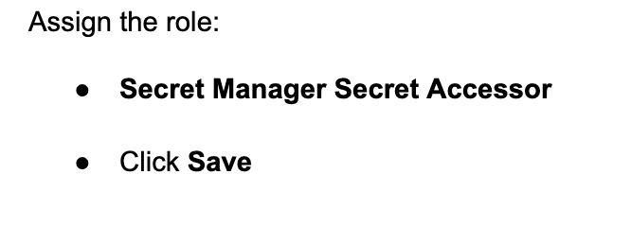
Connecting GitHub to BigQuery Repos

Slide 64
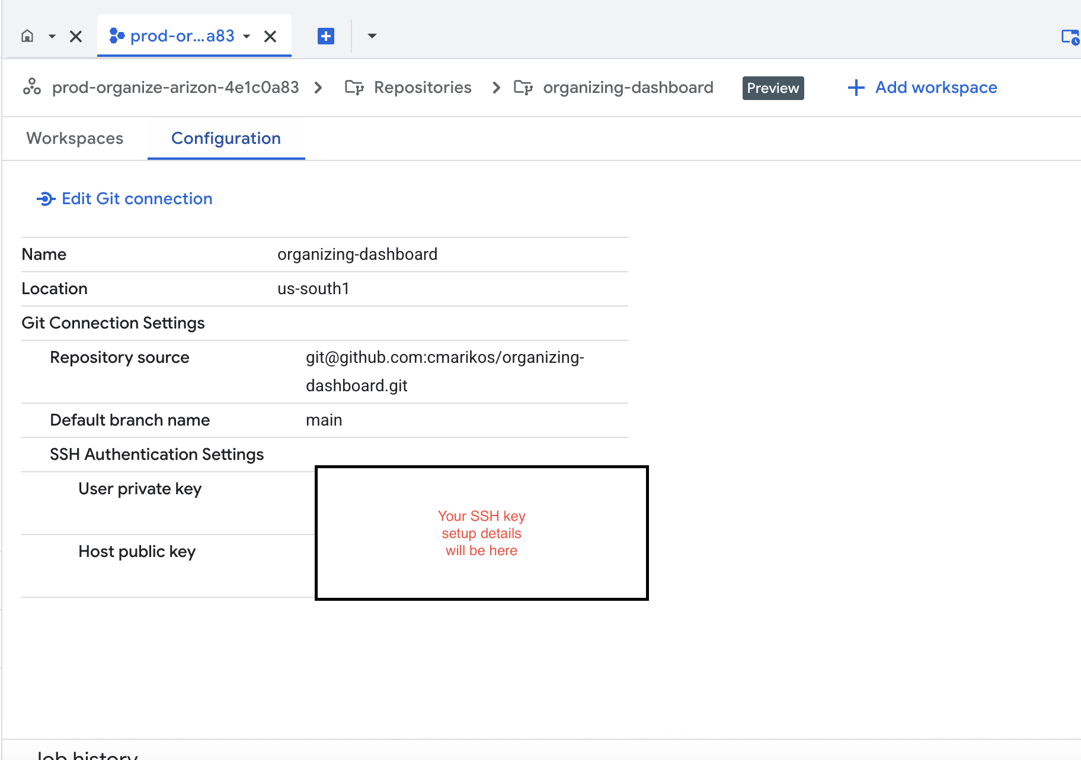
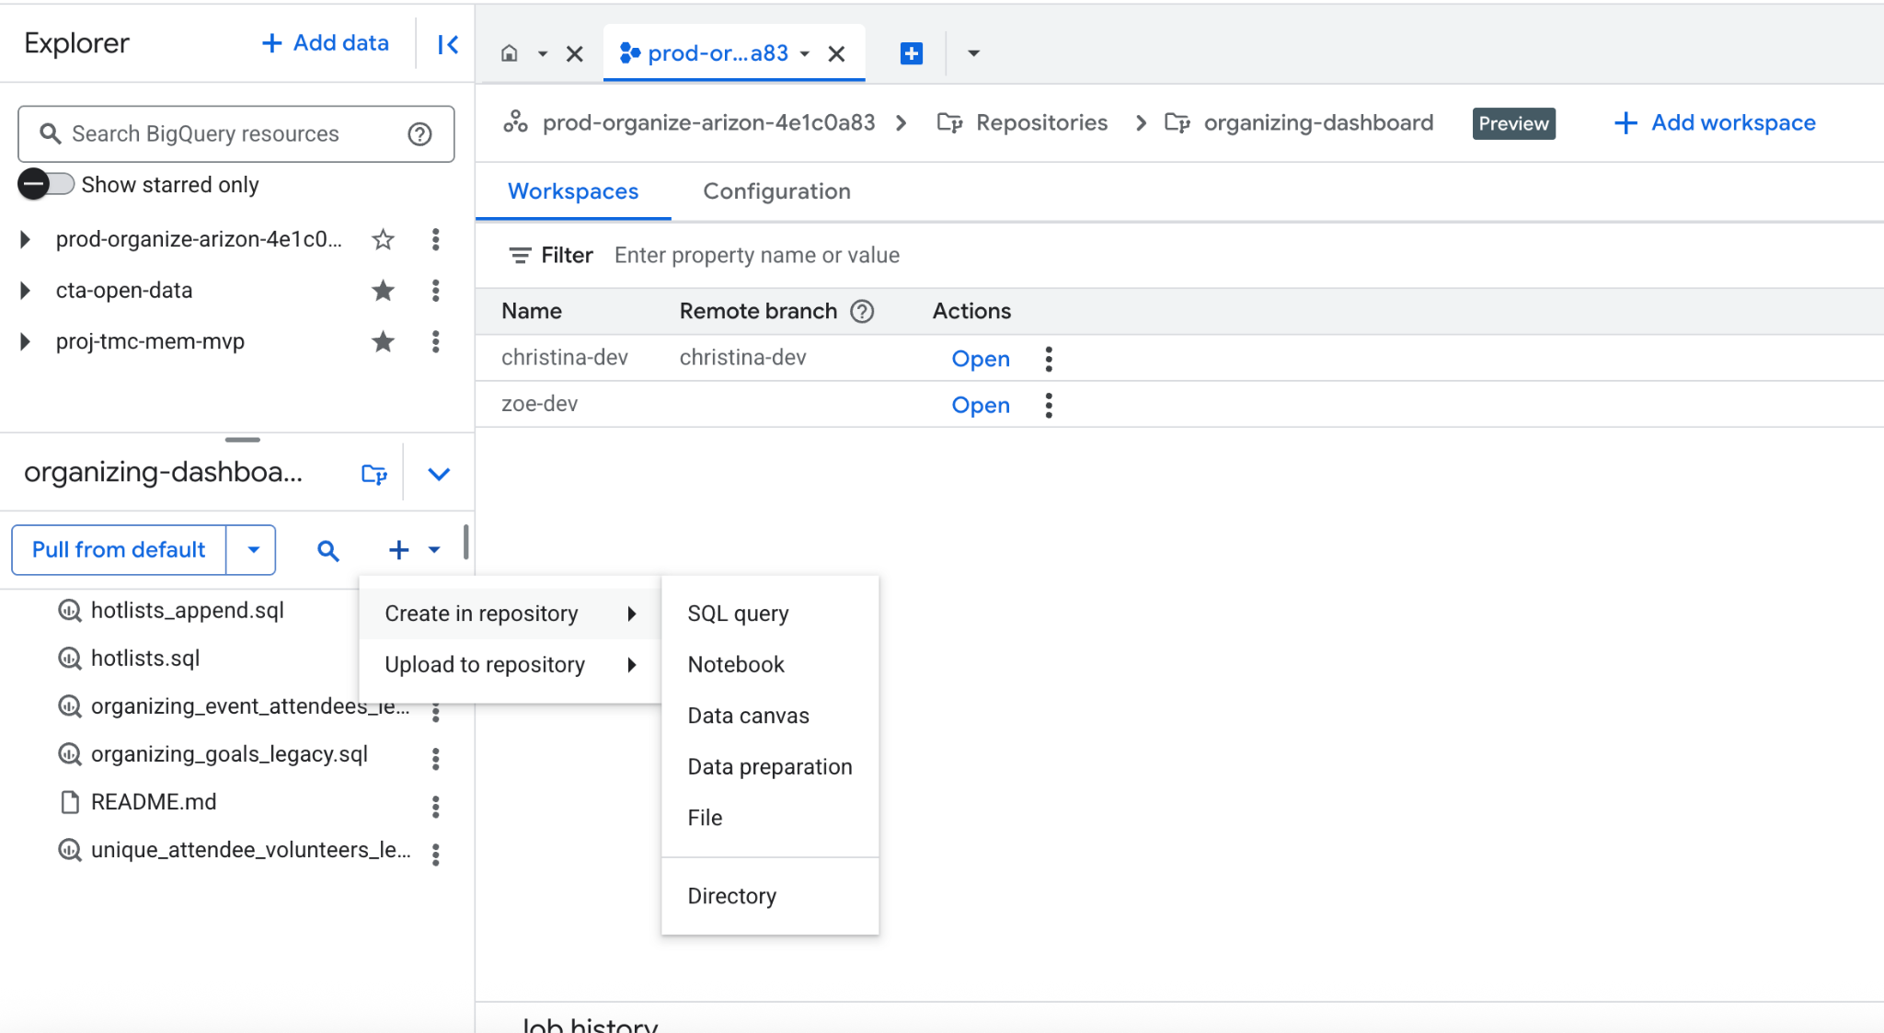
Connecting GitHub to BigQuery Repos - write versioned queries

Slide 65
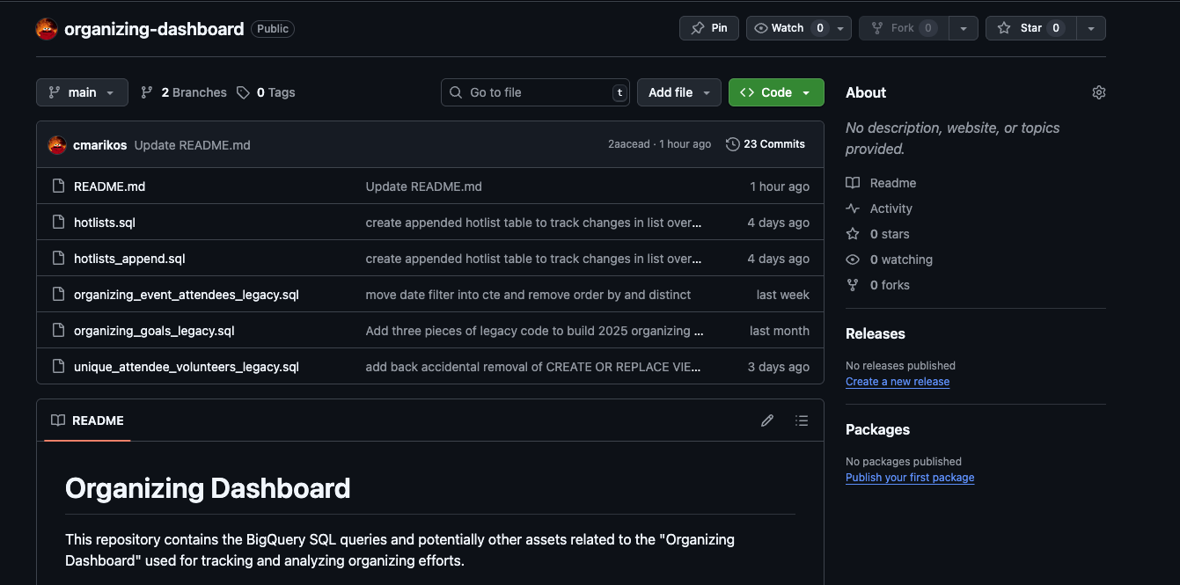
Connecting GitHub to BigQuery Repos - your work in GitHub

Slide 66
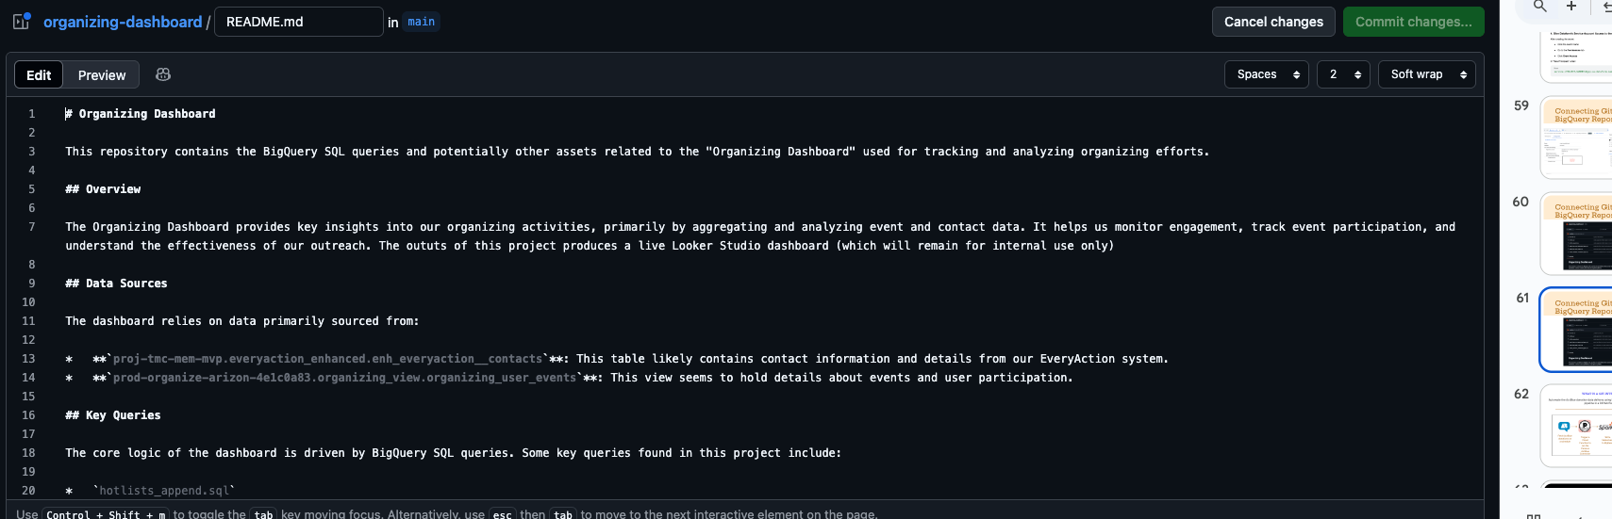
Connecting GitHub to BigQuery Repos - make changes on GitHub

Slide 67
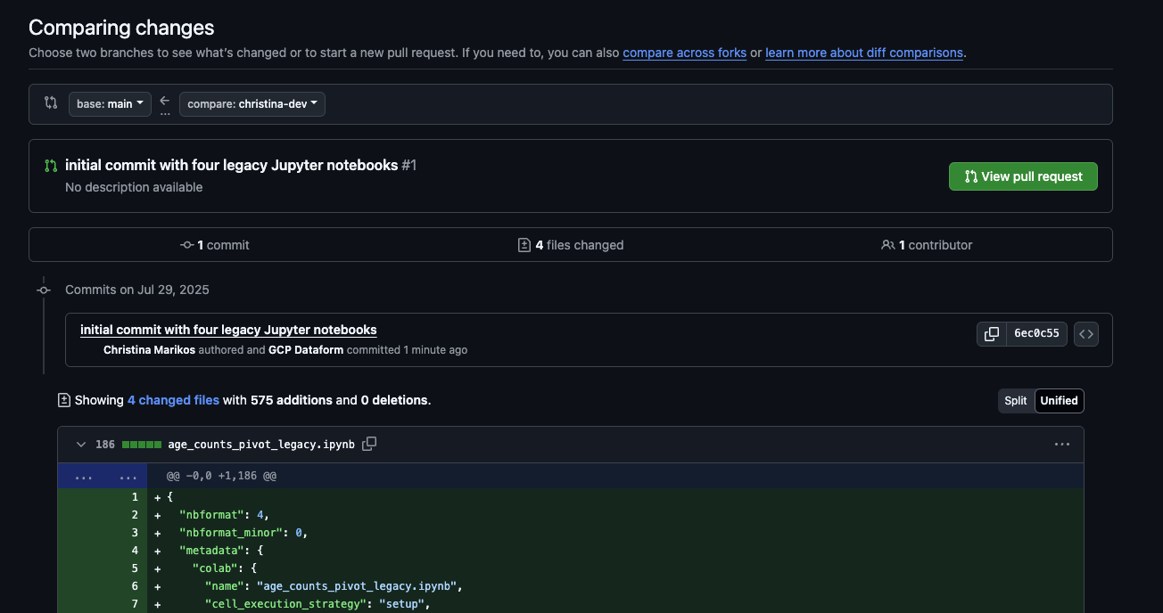
Connecting GitHub to BigQuery Repos - pull requests

Slide 68
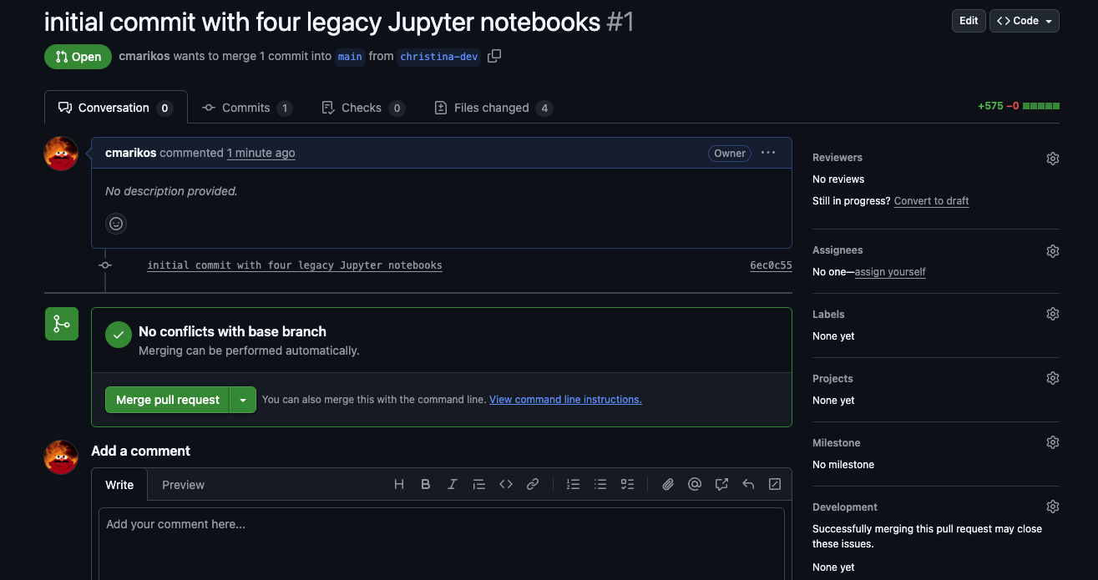
Connecting GitHub to BigQuery Repos - pull requests

Slide 69
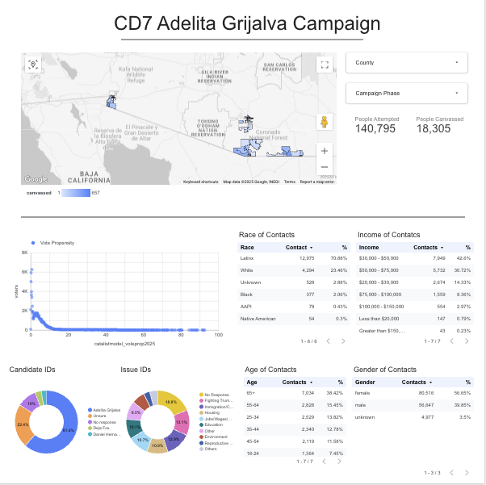
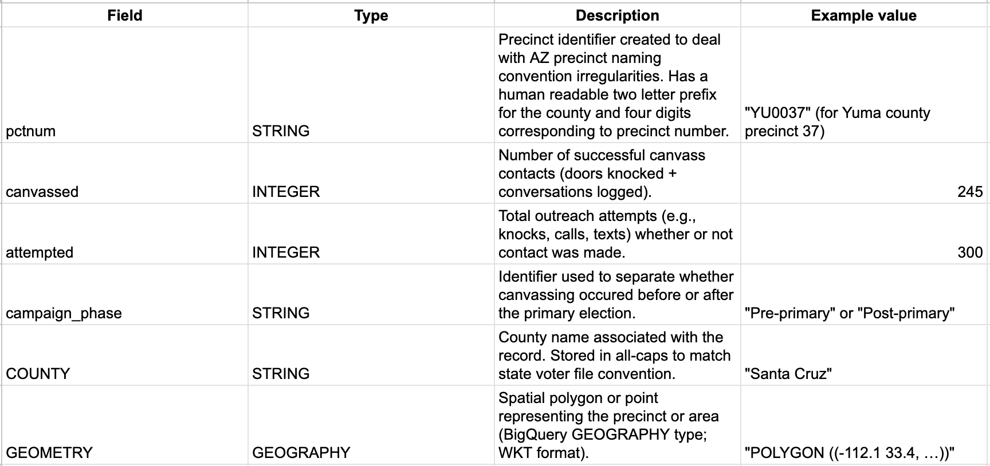
CIRCLING BACK: Data Dictionaries
Create a dictionary of views created that support your final product
This is a dictionary for the view that supports the top half of this dashboard

Slide 70
Warning: BigQuery Scheduled Queries
BQ Repos doesn’t currently talk to the query scheduler
Manually paste queries into it and edit them
Can’t specify order in which you want things to run - schedule sequential times and hope nothing fails
No built in documentation!!!
If this is the route you take (and it is a valid route to take) - keep each of these points in mind and make sure your documentation includes details

Slide 71
Turn isolated SQL queries into a dependable, documented, intentional pipeline
There are better trainings than this on data engineering
Going to briefly touch on these
Dataform/dbt
You can kind of create mini-workflows that function like a pipeline using python scripts
GCS supports Jupyter notebooks and managed serverless spark
Jupyter notebooks/Serverless Spark
CHECKPOINT: for some work this is enough
For a lot of state and local organizations like mine, there is no need to move beyond the steps outlined before this point, the gap is documentation up to this point. We’re going to briefly touch on the following and how they can be a fully documented pipeline

Slide 72
dbt/Dataform
Dataform - if you work in BigQuery only this is a decent option to get into engineering
dbt - a more universal + data warehouse neutral option
Both support Git integration
If you’re at this step you probably don’t need me to tell you how to use Git
These are good investments if you have the time/money/expertise
But you can get by without proper ETL while still versioning start to finish

Slide 73


BigQuery’s Python Notebooks
BigQuery has built in Jupyter notebooks and serverless Spark sessions
They allow you to version how and in what order your queries run
Transform in ways that SQL isn’t suited to
Work innumerable imported libraries

Slide 74
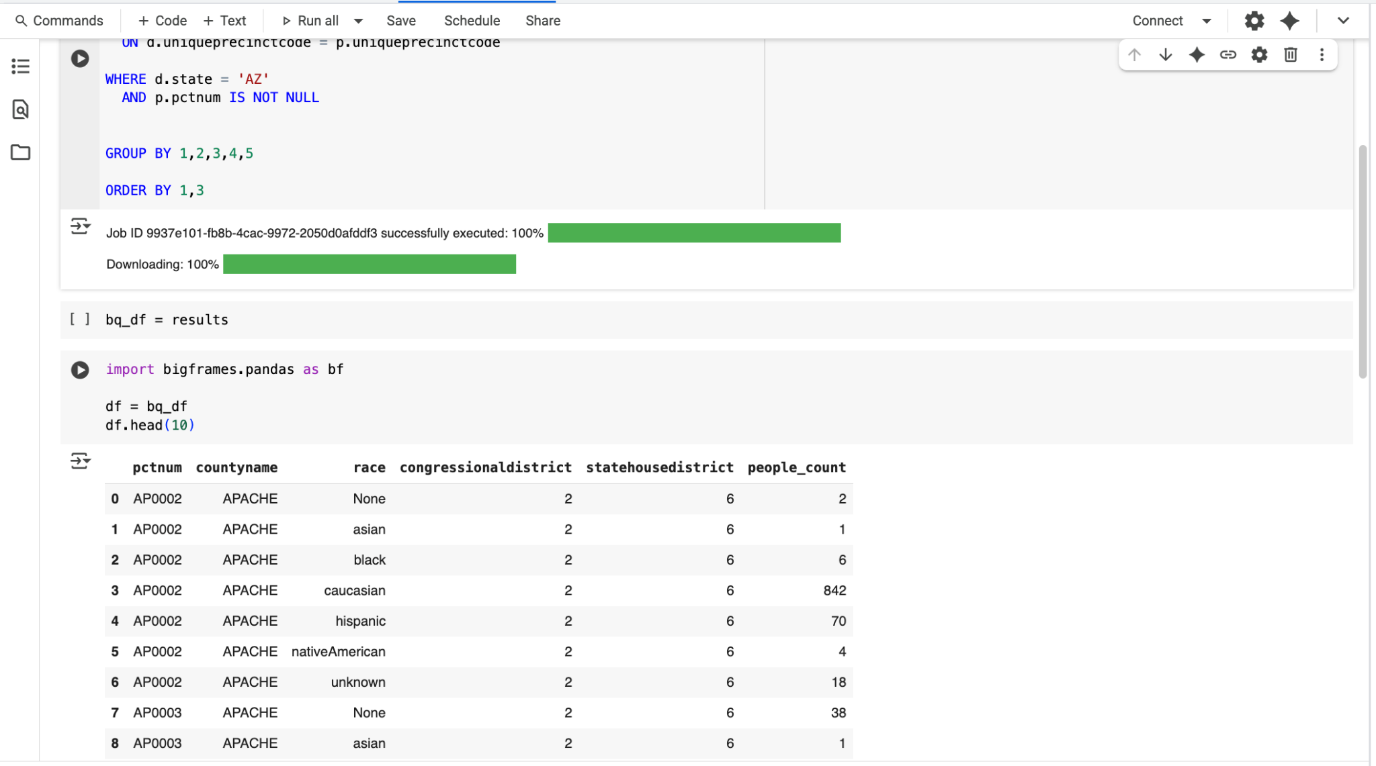
Python notebooks in BigQuery
Code blocks run sequentially
Ability to add text blocks within your notebook space
Script queries to run in a specific order
Write outputs back to BigQuery
Can live inside your BigQuery repo
Not great

Slide 75
BigQuery’s Spark Sessions - notebooks for BIG projects
If you are working with a dataset >16GB or one that you expect will grow above that point
Planning proactively for work that you expect to outgrow your notebooks/queries
PySpark dataframes are great
Painful SQL functions happen super easily
No back and forth between SQL and Pandas
This isn’t using Spark to it’s potential. It does a lot more than sequence queries and transform datasets.

Slide 76
People engaged in and committed to the kinds of work we do make good data people, who will have deeper grounding in the work on the ground not just the work in the data warehouse
All of the best work in this ecosystem comes from dedication to our community and commitment to uplift people along the way
The goal of this project is to demystify and provide un-intimidating look at good documentation practices so that our work can be built upon year to year, and can be used as a learning tool for people we invest in
Data Anarchy (But Well Documented!!!)
Returning to the grounding that brought us here

Slide 77

Post-training resources

Slide 78
Which of the things we covered today is most applicable to your work?

Slide 79
04
Q&A

Slide 80
THANK YOU

